Slide 1
Home

Slide 2
A successful career choice begins with learning about yourself.
Home
Glencoe Accounting
Copyright © by The McGraw-Hill Companies, Inc. All rights reserved.

Slide 3
Describe how personal skills, values, and lifestyle goals affect career decisions.
Find information about a variety of careers.
Set career goals.
Identify career opportunities in the accounting field.
Describe the types of businesses and organizations that hire accountants.
Compare for-profit businesses and not-for-profit organizations.
Home
Glencoe Accounting
Copyright © by The McGraw-Hill Companies, Inc. All rights reserved.

Slide 4
Section 1.1
Exploring Careers
Key Terms
skills
values
lifestyle
personality
personal interest tests
networking
Home

Slide 5
Choosing a Career
Section 1.1
Exploring Careers
foundation of interest
A career is not just work for pay and is built on
knowledge
training
experience
Home

Slide 6
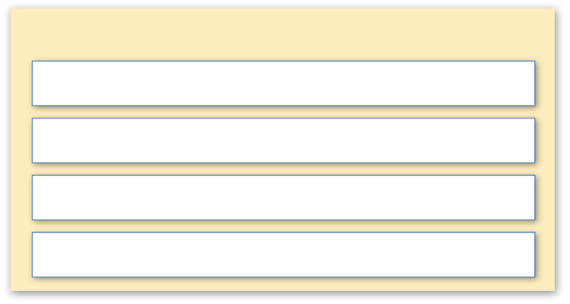
Assess Yourself in Terms of a Career Vision
Section 1.1
Exploring Careers
To help make your career choice, ask yourself these questions:
What are your personal interests and skills?
What are your values, and how will they affect your career?
What lifestyle interests you?
How will your personality affect your career choice?
Home

Slide 7
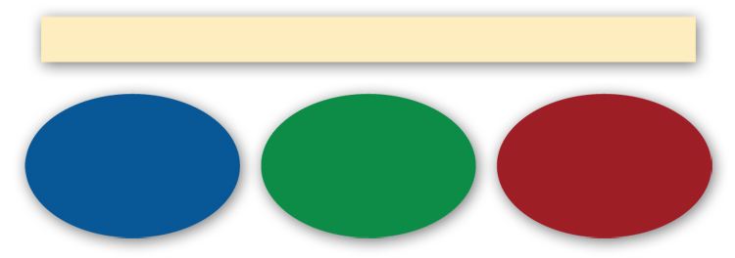
Assess Yourself in Terms of a Career Vision
Section 1.1
Exploring Careers
You are more likely to enjoy a career that uses your:
Interests
Skills
Traits
skills
The activities that a person does well.
Home

Slide 8
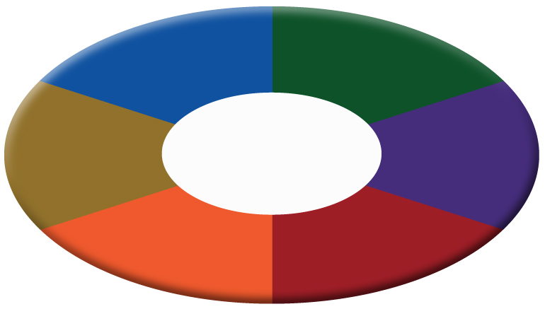
Assess Yourself in Terms of a Career Vision
Section 1.1
Exploring Careers
responsibility
achievement
Examples of Values
recognition
relationships
courage
compassion
values
The principles a person lives by and the beliefs that are important to the person.
Home

Slide 9
Assess Yourself in Terms of a Career Vision
Section 1.1
Exploring Careers
To help determine your lifestyle goals, begin by asking yourself these questions:
What is really important to you?
Do you want to go for the big bucks?
Do you want to live in a big city or a small town?
Do you want to work in a group or by yourself?
lifestyle
The way a person uses time, energy, and resources.
Home

Slide 10
Assess Yourself in Terms of a Career Vision
Section 1.1
Exploring Careers
Confident?
Dependable?
Think about your personality. Are you:
Funny?
Friendly?
personality
A set of unique qualities that makes a person different from all other people.
Sympathetic?
Home

Slide 11
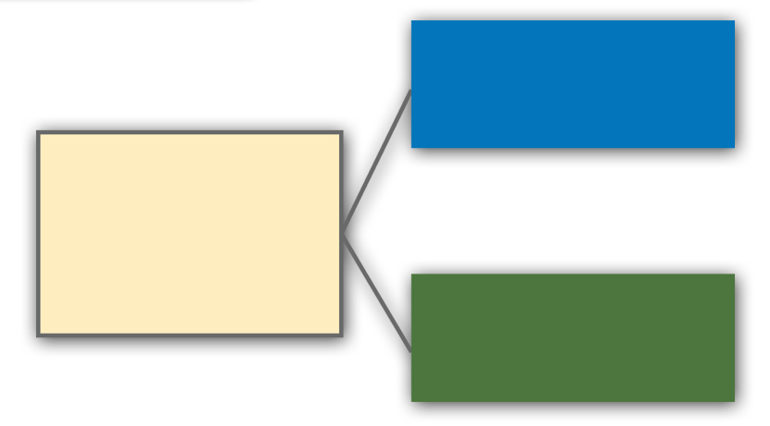
Making Career Decisions
Section 1.1
Exploring Careers
Research career goals
After you have determined who you are and what you like to do, you are ready to
Set goals
Home

Slide 12
Making Career Decisions
Section 1.1
Exploring Careers
Speak with a school counselor and complete a personal interest test.
Make contacts by networking.
To help find the right career for you:
Visit the library and research different careers.
Search the Internet for educational and career information.
Get involved in professional organizations.
personal interest tests
Tests that help individuals identify their preferences and match their interests to potential careers.
networking
Making contacts with people to share information and advice.
Home

Slide 13
Making Career Decisions
Section 1.1
Exploring Careers
After you have a clear vision of yourself, you should:
Map out a plan to help you achieve your career goals.
Seek the required education or training.
Get on-the-job training.
Look for internship possibilities.
Home

Slide 14
Accounting Careers: The Possibilities are Endless!
Section 1.2
Key Terms
accountant
accounting clerk
for-profit business
not-for-profit organization
public accounting firm
audit
certified public accountant (CPA)
Home

Slide 15
The Changing Horizon
1.2
Accounting Careers: The Possibilities are Endless!
Section 1.2
As an accountant, you could work for
Big-name businesses like Nike or Hard Rock Cafe
Movie producers
Well-known celebrities like Will Smith or Natalie Portman
Publishers of magazines such as PC World or Sports Illustrated
Home

Slide 16
Types of Organizations
Accounting Careers: The Possibilities are Endless!
Section 1.2
There are many career opportunities for accountants in
for-profit business
A business that operates to earn money for its owners.
For-profit businesses
not-for-profit organization
An organization that operates for purposes other than making a profit.
Not-for-profit organizations
Public accounting firms
Home

Slide 17
Types of Organizations
Accounting Careers: The Possibilities are Endless!
Section 1.2
What Is an Accounting Clerk?
accounting clerk
An entry-level job that can vary from specializing in one part of the system to doing a wide range of tasks.
Home

Slide 18
Types of Organizations
Accounting Careers: The Possibilities are Endless!
Section 1.2
$
$
Donations
Tax Dollars
Revenues
Expenses
Home

Slide 19
Types of Organizations
Accounting Careers: The Possibilities are Endless!
Section 1.2
Public Accounting Firms
Certified public accountants perform:
Some well-known public accounting firms are:
audits
financial planning
tax document preparation
Ernst & Young
Deloitte & Touche
KPMG
PricewaterhouseCoopers
audit
The review of a company’s accounting systems and financial statements to confirm that they follow generally accepted accounting principles.
Home

Slide 20
Question 1
Fill in the blank to identify:
F = businesses you think are for-profit businesses
N = businesses you think are not-for-profit organizations
P = businesses you think are public accounting firms
F
P
Deloitte & Touche
General Motors
F
N
MTV
National Cathedral
N
F
American Lung Association
Boeing
P
P
PricewaterhouseCoopers
Ernst & Young
F
P
Walt Disney World
KPMG
Home

Slide 21
Question 2
List several sources within your school where you can collect career information.
Possible answers include guidance counselors, print materials in the library or career center, and the Internet. Other possibilities could be guest speakers, teachers, and other staff members.
Home

Slide 22
End of
Home

