Slide 1
Home

Slide 2
Internal controls are steps taken to protect assets and keep reliable records. The bank reconciliation is an important internal control.
Home
Glencoe Accounting
Copyright © by The McGraw-Hill Companies, Inc. All rights reserved.

Slide 3
Describe the internal controls used to protect cash.
Describe the forms needed to open and use a checking account.
Record information on check stubs.
Prepare a check.
Prepare bank deposits.
Reconcile a bank statement.
Journalize and post entries relating to bank service charges.
Describe the uses of the electronic funds transfer system.
Home
Glencoe Accounting
Copyright © by The McGraw-Hill Companies, Inc. All rights reserved.

Slide 4
Section 11.1
Banking Procedures
Key Terms
internal controls
external controls
checking account
check
depositor
signature card
deposit slip
endorsement
blank endorsement
special endorsement
restrictive endorsement
payee
drawer
drawee
voiding a check
Home

Slide 5
Protecting Cash
Section 11.1
Banking Procedures
Internal Controls
Two ways to protect cash:
External Controls
internal controls
Procedures within the business that are designed to protect cash and other assets and to keep reliable records.
external controls
Measures and procedures provided outside the business to protect cash and other assets.
Home

Slide 6
The Checking Account
Section 11.1
Banking Procedures
A checking account holds cash deposits made by the depositor, whether a person or business, and allows them to write a check against the balance.
checking account
An account that allows a person or business to deposit cash in a bank and then write checks and make ATM withdrawals and purchases against the account balance.
depositor
A person or business that has cash on deposit in a bank.
check
A written order from a depositor telling the bank to pay a stated amount of cash to the person or business named on the check.
Home

Slide 7
The Checking Account
Section 11.1
Banking Procedures
Protects cash
A checking account:
Provides a record of transactions
Home

Slide 8
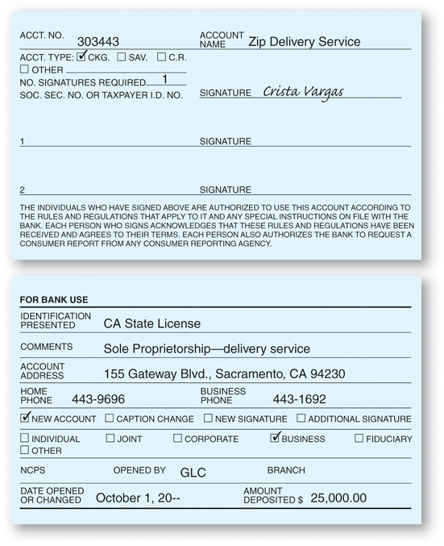
The Checking Account
Section 11.1
Banking Procedures
The Signature Card
signature card
A bank form containing the signature(s) of the person(s) authorized to write checks on a checking account.
Home
See page 282

Slide 9
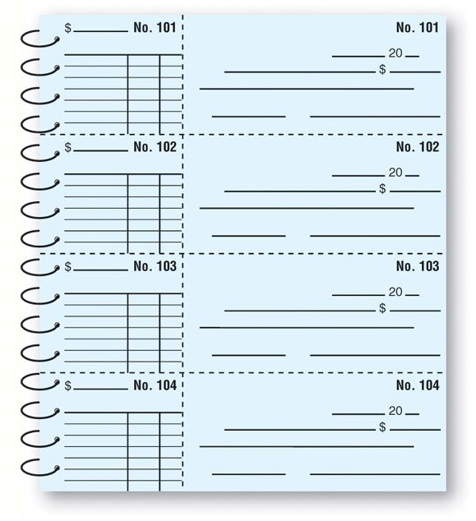
The Checking Account
Section 11.1
Banking Procedures
The Checkbook
Detachable check
Check stub
Numbered in sequence
Home
See page 282

Slide 10
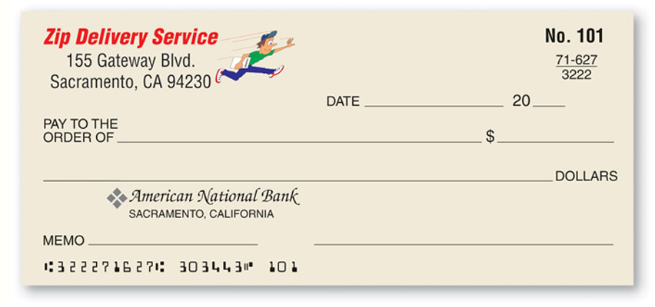
The Checking Account
Section 11.1
Banking Procedures
The Printed Check
ABA number
Identifies the bank.
Speeds the handling of printed checks.
See page 283
Home

Slide 11
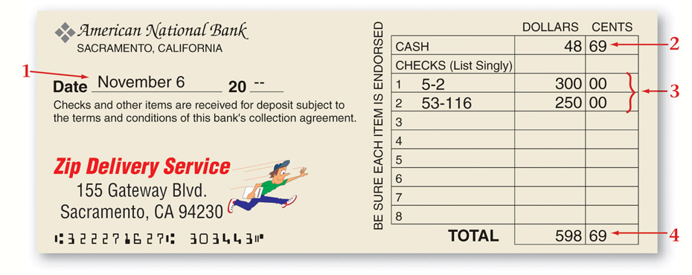
The Checking Account
Section 11.1
Banking Procedures
The Deposit Slip
See page 283
deposit slip
A bank form used to list the cash and checks to be deposited.
Home

Slide 12
The Checking Account
Section 11.1
Banking Procedures
Completing a Deposit
Write the date on the Date line.
Indicate the total currency and coins on the Cash line.
List checks separately by their ABA numbers.
Add the amounts and enter the total on the Total line.
Home

Slide 13
The Checking Account
Section 11.1
Banking Procedures
The depositor’s endorsement is needed to deposit a check in a checking account.
endorsement
A check endorsement that includes only the signature or stamp of the depositor. It does not specify the new owner of the check.
Home

Slide 14
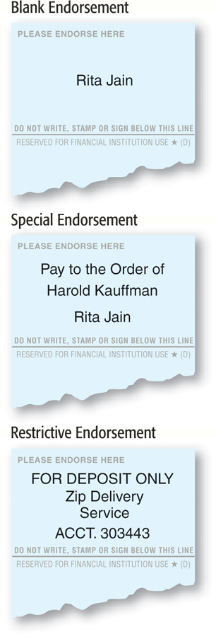
The Checking Account
Section 11.1
Banking Procedures
blank endorsement
A check endorsement that includes only the signature or stamp of the depositor. It does not specify the new owner of the check.
special endorsement
A check endorsement that a transfers ownership of the check to a specific individual or business.
restrictive endorsement
A check endorsement that transfers ownership to a specific owner and limits how the check may be handled (for example, For Deposit Only).
Home

Slide 15
The Checking Account
Section 11.1
Banking Procedures
Recording a Deposit
Enter the date of deposit in the Add deposits line on the check stub for the next unused check.
Enter the total amount of the deposit.
Add the deposit amounts to the amount on the Balance brought forward line and enter the total on the Total line.
Home

Slide 16
The Checking Account
Section 11.1
Banking Procedures
Rules for Writing a Check
Complete checks in ink.
Complete the check stub before writing the check.
Home

Slide 17
The Checking Account
Section 11.1
Banking Procedures
Two Parts of the Check Stub
The upper part containing the amount of the check, the date, the name of the payee, and the purpose of the check.
The lower part containing a record of how the transaction affects the checking account.
payee
The person or business to whom a check is written or a note is payable.
Home

Slide 18
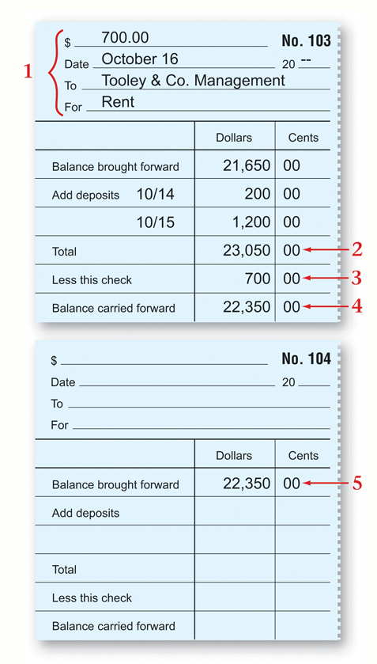
The Checking Account
Section 11.1
Banking Procedures
The Check Stub
See page 285
Home

Slide 19
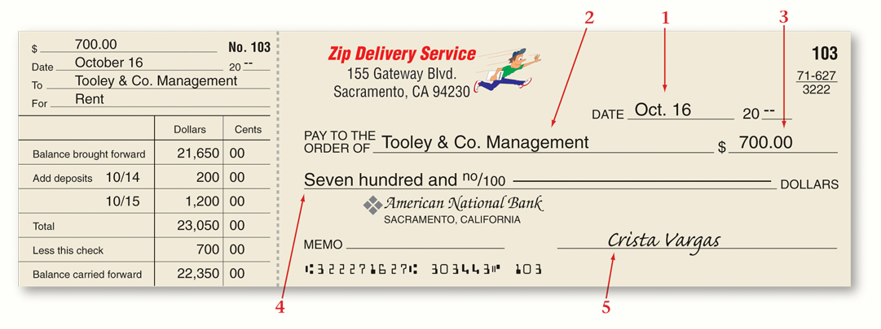
The Checking Account
Section 11.1
Banking Procedures
Completing the Check
drawee
The bank on which the check is written.
Write the date the check is being issued.
Enter the payee’s name on the Pay To Order Of line.
Enter the amount of the check in numbers.
Write the dollar amount of the check in words.
The drawee requires that the check is signed by the drawer.
drawer
The person who signs a check.
Home
See page 285

Slide 20
The Checking Account
Section 11.1
Banking Procedures
Voiding a check is necessary if a mistake is made while writing a check.
voiding a check
Making a check unusable by writing the word Void in ink across the front of the check.
Home

Slide 21
Section 11.2
Reconciling the Bank Statement
Key Terms
bank statement
canceled check
imaged check
reconciling the bank statement
outstanding check
outstanding deposit
bank service charge
stop payment order
NSF check
Check 21
postdated check
electronic funds transfer system
bankcard
automated teller machine (ATM)
Home

Slide 22
Proving Cash
Section 11.2
Reconciling the Bank Statement
Comparing the Cash in Bank account balance with the checkbook is called proving cash.
Common Checkbook Errors
A mistake in copying the balance forward amount to the next check stub
Faulty addition or subtraction
Failure to record a deposit or a check
Home

Slide 23
The Bank Statement
Section 11.2
Reconciling the Bank Statement
Information in a Bank Statement
The checking account balance at the beginning of the period
A list of all deposits
A list of all checks paid by the bank
A list of any other deductions
The checking account balance at the end of the period
bank statement
An itemized record of all the transactions in a depositor’s account over a given period, usually a month.
Home

Slide 24
The Bank Statement
Section 11.2
Reconciling the Bank Statement
A bank usually returns canceled checks as imaged checks with the bank statement.
canceled check
A check paid by the bank, deducted from the depositor’s account, and returned with the bank statement to the account holder.
imaged check
A copy of a canceled check; it is sent with the bank statement in place of the original canceled check.
Home

Slide 25
The Bank Statement
Section 11.2
Reconciling the Bank Statement
Reconciling the bank statement is also known as a bank reconciliation.
reconciling the bank statement
The process of determining any differences between a bank statement balance and a checkbook balance.
Home

Slide 26
The Bank Statement
Section 11.2
Reconciling the Bank Statement
In banking terms, the word outstanding means “not yet received.”
What are outstanding checks?
outstanding check
A check that has been written but has not yet been presented to the bank for payment.
Home

Slide 27
The Bank Statement
Section 11.2
Reconciling the Bank Statement
In banking terms, the word outstanding means “not yet received.”
What are outstanding deposits?
outstanding deposit
A deposit that has been made and recorded in the checkbook but does not yet appear on the bank statement.
Home

Slide 28
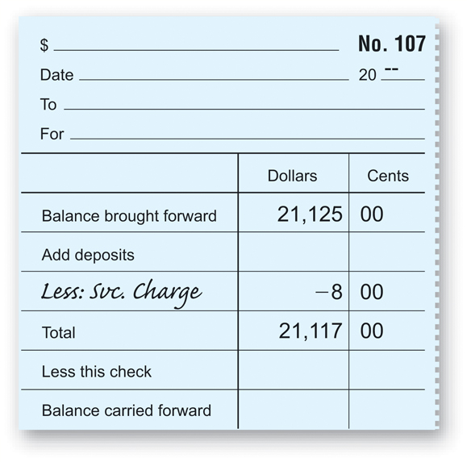
The Bank Statement
Section 11.2
Reconciling the Bank Statement
Entering a Bank Service Charge on the Check Stub
bank service charge
A fee the bank charges for maintaining bank records and processing bank statement items for the depositor.
Home
See page 289

Slide 29
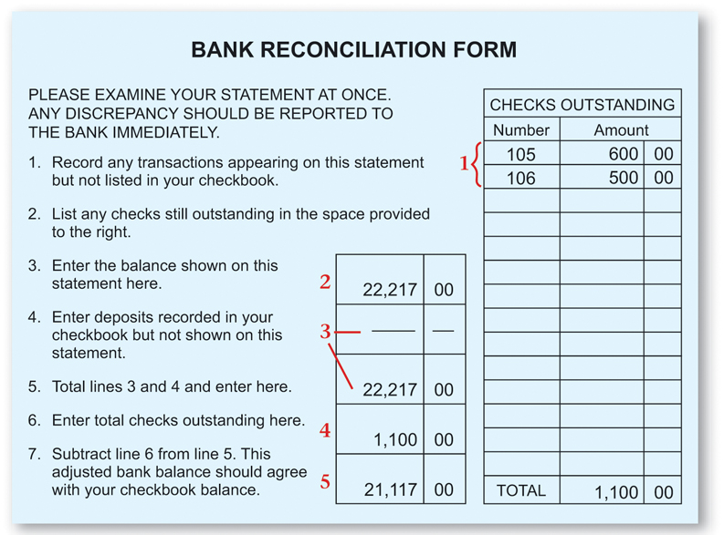
The Bank Statement
Section 11.2
Reconciling the Bank Statement
Home
See page 290

Slide 30
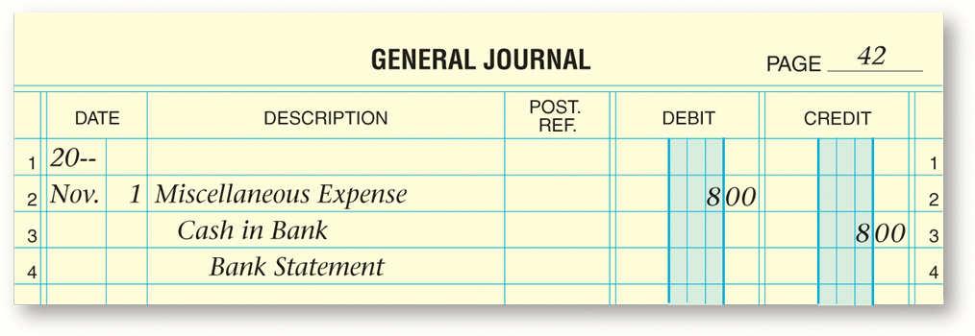
The Bank Statement
Section 10.1
Preparing Closing Entries
Journalizing Bank Service Charges
Business Transaction
On November 1, Zip received the bank statement. A bank service charge of $8 appeared on the statement.
Home
See page 291

Slide 31
The Bank Statment
Section 11.2
Reconciling the Bank Statement
Recording a Stop Payment Order
Write Stopped Payment on the check stub for the stopped check.
Add the amount of the stopped check on the next unused check stub.
stop payment order
A demand by the drawer, usually in writing, that the bank not honor a specific check.
Home

Slide 32
The Bank Statement
Section 11.2
Reconciling the Bank Statement
NSF stands for Not Sufficient Funds
What is an NSF check?
NSF check
A check returned to the depositor by the bank because the drawer’s checking account does not have sufficient funds to cover the amount; also called dishonored check.
Home

Slide 33
The Bank Statement
Section 11.2
Reconciling the Bank Statement
Check 21 went into effect in 2004.
Check 21
The Check Clearing for the 21st Century Act; it allows the conversion of a paper check to an electronic image that can be quickly processed between banks.
Home

Slide 34
The Bank Statement
Section 11.2
Reconciling the Bank Statement
A postdated check should not be deposited until the date that appears on the check.
postdated check
A check that has a future date instead of the actual date; it should not be deposited until the date on the check.
Home

Slide 35
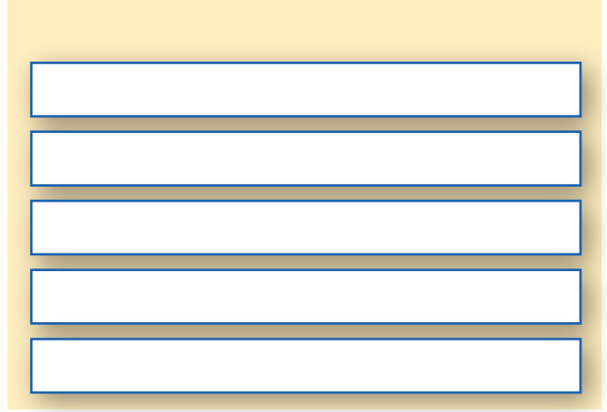
Electronic Funds Transfer System
Section 11.2
Reconciling the Bank Statement
How the Electronic Funds Transfer System (EFTS) Affects Banking
Direct payroll deposit
electronic funds transfer system (EFTS)
A system that allows banks to transfer funds among accounts quickly and accurately without the exchange of checks.
Automated bill paying
Bankcards used at automated teller machines (ATMs)
Bank-by-phone
Online banking
Home

Slide 36
Electronic Funds Transfer System
Section 11.2
Reconciling the Bank Statement
How the Electronic Funds Transfer System (EFTS) Affects Banking
bankcard
A bank-issued card honored by many businesses that can be used to withdraw cash and to make payments for goods and services at many businesses instead of writing checks; also called a debit card, ATM card, or check card.
Direct payroll deposit
Automated bill paying
Bankcards used at automated teller machines (ATMs)
Bank-by-phone
Online banking
Home

Slide 37
Electronic Funds Transfer System
Section 11.2
Reconciling the Bank Statement
How the Electronic Funds Transfer System (EFTS) Affects Banking
Direct payroll deposit
automated teller machine (ATM)
Computer terminal where account holders can conduct various banking activities.
Automated bill paying
Bankcards used at automated teller machines (ATMS)
Bank-by-phone
Online banking
Home

Slide 38
Question 1
You have just received your bank statement for the month. What are the steps in reconciling the bank statement to the checkbook balance?
Step 1
Arrange canceled checks in numerical order; compare them with the checks listed in the checkbook stubs and place a check mark beside the amount on the bank statement and check stub; list the outstanding checks (those with no check marks) and their amounts on the bank reconciliation form.
(continued)
Home

Slide 39
Question 1
You have just received your bank statement for the month. What are the steps in reconciling the bank statement to the checkbook balance?
Step 2
Enter the ending balance shown on the bank statement in the proper box.
(continued)
Home

Slide 40
Question 1
You have just received your bank statement for the month. What are the steps in reconciling the bank statement to the checkbook balance?
Step 3
Compare the deposits listed on the bank statement to deposits in the checkbook. Enter the total of any outstanding deposits on the bank reconciliation form. Add this total to the bank statement balance and enter the sum on the form.
(continued)
Home

Slide 41
Question 1
You have just received your bank statement for the month. What are the steps in reconciling the bank statement to the checkbook balance?
Step 4
Subtract the total of the outstanding checks (Step 1) from the amount calculated in Step 3. This is the adjusted bank balance.
(continued)
Home

Slide 42
Question 1
You have just received your bank statement for the month. What are the steps in reconciling the bank statement to the checkbook balance?
Step 5
Compare the adjusted bank balance and the checkbook balance. When they agree, the bank statement has been reconciled.
Home

Slide 43
Question 2
Do the following regarding the bank statement:
List at least two pieces of information that you can learn from the monthly bank statement.
List at least two reasons why it is important to reconcile the bank statement monthly.
You can find out a number of important facts from the bank statement:
Checks that have been cashed by the payee (cleared).
Deposits that have been received by the bank.
Any service fees that the bank assessed during the period.
The beginning and ending balances.
(continued)
Home

Slide 44
Question 2
Do the following regarding the bank statement:
List at least two pieces of information that you can learn from the monthly bank statement.
List at least two reasons why it is important to reconcile the bank statement monthly.
Reconciling the bank statement monthly allows you to do the following:
Determine an accurate cash balance.
Maintain accurate accounting records.
Maintain good internal control over cash.
Home

Slide 45
End of
Home

