Slide 1
Home

Slide 2
Gross earnings is the total amount an employee earns in a pay period. Payroll deductions are amounts withheld from an employee’s gross earnings.
Home
Glencoe Accounting
Copyright © by The McGraw-Hill Companies, Inc. All rights reserved.

Slide 3
Explain the importance of accurate payroll records.
Compute gross pay using different methods.
Explain and compute employee-paid withholdings.
Compute net pay.
Prepare payroll registers.
Explain the methods of distributing payroll funds.
Prepare an employee’s earnings record.
Home
Glencoe Accounting
Copyright © by The McGraw-Hill Companies, Inc. All rights reserved.

Slide 4
Section 12.1
Calculating Gross Earnings
Key Terms
payroll
pay period
payroll clerk
gross earnings
salary
wage
time card
electronic badge reader
commission
piece rate
overtime rate
Home

Slide 5
Using a Payroll System
Section 12.1
Calculating Gross Earnings
Payroll
The collection and processing of all information needed to prepare and issue payroll checks
The generation of payroll records needed for accounting purposes and for reporting to government agencies, management, and others
payroll
A list of the employees and the payments due to each employee for a specific pay period.
Home

Slide 6
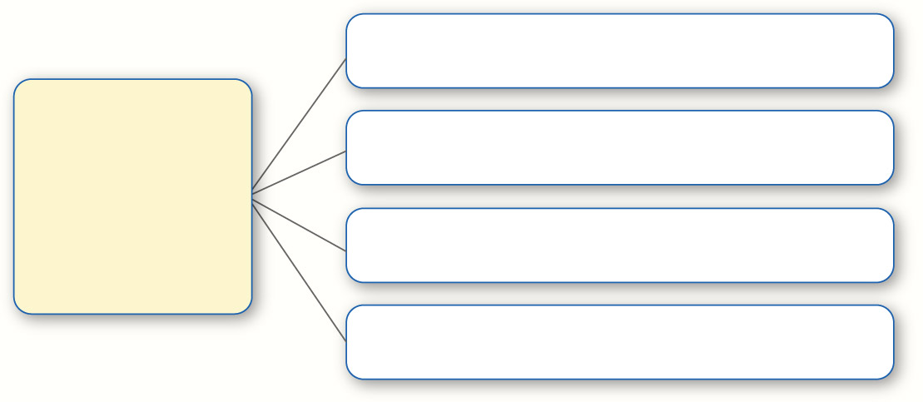
Using a Payroll System
Section 12.1
Calculating Gross Earnings
Weekly
Most Pay Periods Are Either:
Biweekly
Semimonthly
Monthly
pay period
The amount of time over which an employee is paid.
Home

Slide 7
Using a Payroll System
Section 12.1
Calculating Gross Earnings
Responsibilities of a Payroll Clerk
Makes sure employees are paid on time
Makes sure each employee is paid the correct amount
Completes payroll records
Submits payroll reports
Pays payroll taxes
payroll clerk
An employee responsible for preparing the payroll.
Home

Slide 9
Computing Gross Pay
Section 12.1
Calculating Gross Earnings
Pay Categories That Help Determine Gross Earnings
Salary
Hourly Wage
Commission
Salary plus Commission or Bonus
Piece Rate
gross earnings
The total amount of money an employee earns in a pay period; also called gross pay.
Home

Slide 10
Computing Gross Pay
Section 12.1
Calculating Gross Earnings
Pay Categories That Help Determine Gross Earnings
Salary
Hourly Wage
Commission
Salary plus Commission or Bonus
Piece Rate
salary
A fixed amount of money paid to an employee for each pay period.
Home

Slide 11
Computing Gross Pay
Section 12.1
Calculating Gross Earnings
Pay Categories That Help Determine Gross Earnings
Salary
Hourly Wage
Commission
Salary plus Commission or Bonus
Piece Rate
wage
An amount of money paid to an employee at a specified rate per hour worked.
Home

Slide 12
Computing Gross Pay
Section 12.1
Calculating Gross Earnings
Pay Categories That Help Determine Gross Earnings
Salary
Hourly Wage
Commission
Salary plus Commission or Bonus
Piece Rate
piece rate
A rate of pay based on the number of items produced.
Home

Slide 13
Computing Gross Pay
Section 12.1
Calculating Gross Earnings
Time Card
Two methods of measuring hours worked
Electronic Badge Reader
time card
A record of the time an employee arrives at work, leaves work, and the total number of hours worked each day.
Home

Slide 14
Computing Gross Pay
Section 12.1
Calculating Gross Earnings
Time Card
Two methods of measuring hours worked
Electronic Badge Reader
electronic badge reader
An electronic device that scans the magnetic strip containing employee information on an employee’s identification badge and then transfers the information directly to a computer.
Home

Slide 15
Computing Gross Pay
Section 12.1
Calculating Gross Earnings
Sales employees are often paid a commission. Some sales employees are paid salary plus commission.
commission
An amount paid to an employee based on a percentage of the employee’s sales.
Home

Slide 16
Computing Gross Pay
Section 12.1
Calculating Gross Earnings
Manufacturers often pay a piece rate.
piece rate
A rate of pay based on the number of items produced.
Home

Slide 17
Computing Gross Pay
Section 12.1
Calculating Gross Earnings
The overtime rate was set by the Fair Labor Standards Act of 1938.
overtime rate
Pay rate employers are required to pay certain employees covered by state and federal laws; the Fair Labor Standards Act of 1938 sets the rate at 1.5 times the regular hourly rate after 40 hours per week.
Home

Slide 18
Section 12.2
Payroll Deductions
Key Terms
deduction
withholding allowance
401 (k) plan
Home

Slide 19
Deductions Required by Law
Section 12.2
Payroll Deductions
Deductions Required by Law
Federal Income Tax
Social
Security
Tax
City and State Income Tax
deduction
An amount that is subtracted from an employee’s gross earnings.
Home

Slide 20
Deductions Required by Law
Section 12.2
Payroll Deductions
What Is a withholding allowance?
withholding allowance
An allowance an individual claims on a Form W-4; it is used to calculate the amount of income tax withheld from an employee’s paycheck.
Home

Slide 21
Deductions Required by Law
Section 12.2
Payroll Deductions
Too much money withheld
Refund
from the IRS
Employer withholds federal income tax
Too little money withheld
Amount Due
to the IRS
Home

Slide 22
Deductions Required by Law
Section 12.2
Payroll Deductions
The employee’s marital status (found on Form W-4)
The amount of income tax withheld depends on:
Number of allowances claimed (found on Form W-4)
The employee’s gross earnings
Home

Slide 23
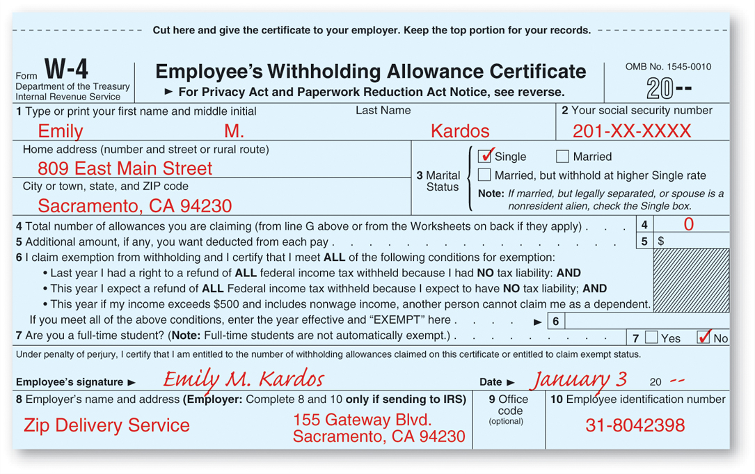
Deductions Required by Law
Section 12.2
Payroll Deductions
Home
See page 319

Slide 24
Deductions Required by Law
Section 12.2
Payroll Deductions
The Federal Insurance Contributions Act (FICA) established social security taxes in 1935. Two components of FICA are:
Social security–provided as old age and disability insurance and survivors’ benefits
Medicare–provides health insurance for people who are elderly or disabled
Home

Slide 25
Voluntary Deductions
Section 12.2
Payroll Deductions
Examples of Voluntary Deductions
Union Dues
Health Insurance Payments
Life Insurance Payments
U.S. Savings Bonds
Charitable Contributions
Pensions
Credit Union Deposits and Payments
Home

Slide 26
Voluntary Deductions
Section 12.2
Payroll Deductions
The 401(k) plan is a popular voluntary payroll deduction.
401(k) plan
A voluntary payroll deduction from gross earnings; the employee does not pay income tax on the amount contributed until the money is withdrawn from the plan, usually after age 59½.
Home

Slide 27
Section 12.3
Payroll Records
Key Terms
payroll register
net pay
direct deposit
employee’s earnings record
accumulated earnings
Home

Slide 28
Preparing the Payroll Register
Section 12.3
Payroll Records
Seven Parts of the Payroll Register
payroll register
A form that summarizes information about employees’ earnings for each pay period.
1. Total Hours Column
2. Rate Column
3. Earnings Section
4. Deductions Section
net pay
The amount left after total deductions have been subtracted from gross earnings.
5. Net Pay Column
6. Check Number Column
7. Column Totals
Home

Slide 29
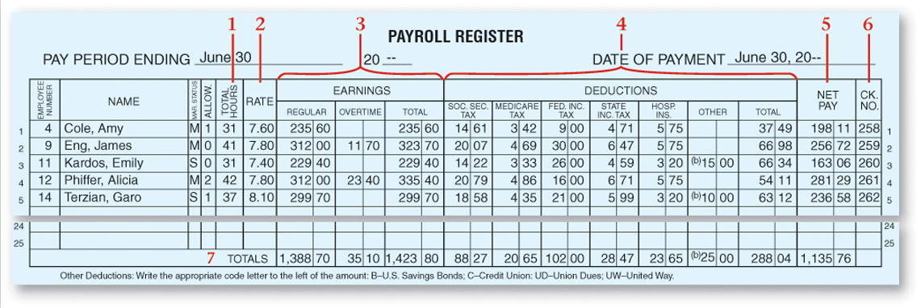
Preparing the Payroll Register
Section 12.3
Payroll Records
See page 323
Total Hours Column
Rate Column
Earnings Section
Deductions Section
Net Pay Column
Check Number Column
Column Totals
Home

Slide 30
Paying Employees
Section 12.3
Payroll Records
Check
Methods of Paying Employees
Direct Deposit
direct deposit
Depositing net pay directly into an employee’s personal bank account through electronic funds transfer.
Home

Slide 31
The Employee’s Earnings Record
Section 12.3
Payroll Records
An employer must also keep an employee’s earning record, which includes accumulated earnings information.
employee’s earning record
A record prepared for each employee that contains all payroll information related to the employee; it is kept on a quarterly basis.
accumulated earnings
The employee’s year-to-date gross earnings.
Home

Slide 32
Managerial Implications for Payroll Accounting
Section 12.3
Payroll Records
How Payroll Information Can Be Used
To determine if overtime is justified.
To compare actual amounts to budgeted amounts to reveal unplanned overtime.
Home

Slide 33
Question 1
Wayne Hanson is paid $9 per hour. He worked 44 hours last week. In addition, he receives time and one-half for overtime. Calculate his gross pay for the week.
Step 1: Multiply his regular pay by the number of hours worked ($9.00 x 40 = $360.00).
Step 2: Calculate the overtime rate by multiplying the regular hourly wage by 1.5 ($9.00 x 1.5 = $13.50).
Step 3: Multiply the number of overtime hours by the overtime rate (44 - 40 = 4 hours of overtime; 4 x $13.50 = $54.00).
Step 4: Add the regular pay and the overtime pay ($360.00 + $54.00 = $414.00).
Home

Slide 34
Question 2
What are at least three pieces of information you can learn from your weekly payroll check?
Among the important facts you can find from your weekly payroll check are these:
The time period in which the work was performed.
The total number of regular hours.
The total number of overtime hours.
Total gross pay.
Amount of Medicare tax withheld.
Amount of social security tax withheld.
Amount of federal income tax withheld.
Amount of state income tax withheld.
Any voluntary deductions withheld.
Total net pay.
10.
Home

Slide 35
End of
Home

