Slide 1
Home

Slide 2
Employers are legally required to make tax deposits on time and to report the earnings of each employee. Employers must pay taxes in addition to the amounts withheld from their employees. This is an expense for the business.
Home
Glencoe Accounting
Copyright © by The McGraw-Hill Companies, Inc. All rights reserved.

Slide 3
Record payroll transactions in the general journal.
Describe the employer’s payroll taxes.
Compute and complete payroll tax expense forms.
Record the payment of tax liabilities in the general journal.
Complete payroll tax reports.
Home
Glencoe Accounting
Copyright © by The McGraw-Hill Companies, Inc. All rights reserved.

Slide 4
Section 13.1
Journalizing and Posting the Payroll
Key Term
Salaries Expense
Home

Slide 5
Analyzing and Journalizing the Payroll
Section 13.1
Journalizing and Posting the Payroll
Employee earnings are an operating expense and are often recorded in the Salaries Expense account.
Salaries Expense
The expense account used to record employees’ earnings.
Home

Slide 6
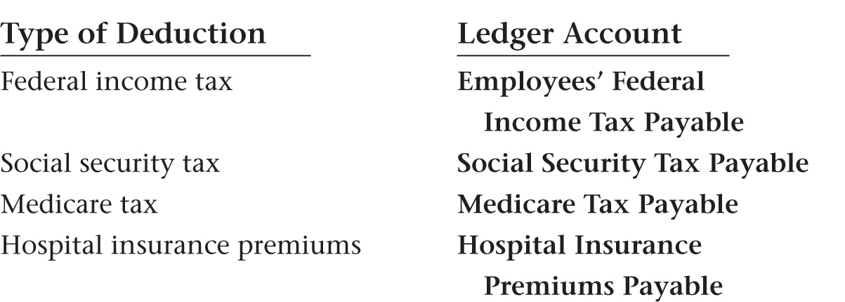
Analyzing and Journalizing the Payroll
Section 13.1
Journalizing and Posting the Payroll
Each type of payroll liability is recorded in a separate account.
Home

Slide 7
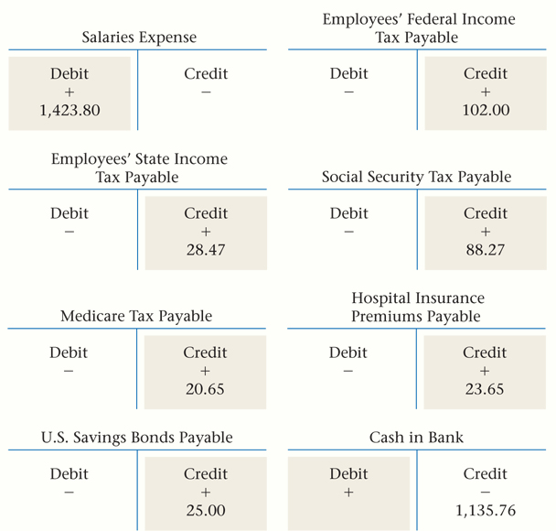
Analyzing and Journalizing the Payroll
Section 13.1
Journalizing and Posting the Payroll
Business Transaction
Zip’s payroll register in Figure 12-5 on page 323 is the source document for the payroll.
See pages 344–345
Home

Slide 8
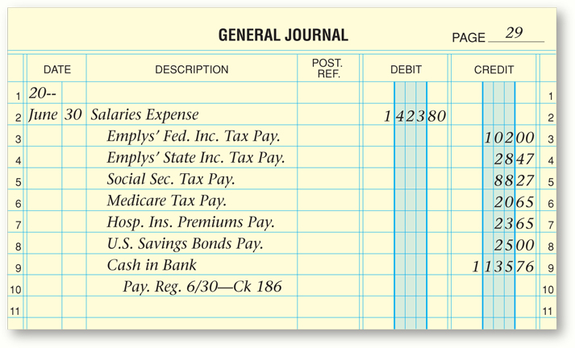
Analyzing and Journalizing the Payroll
Section 13.1
Journalizing and Posting the Payroll
Business Transaction
Zip’s payroll register in Figure 12-5 on page 323 is the source document for the payroll.
See page 345
Home

Slide 9
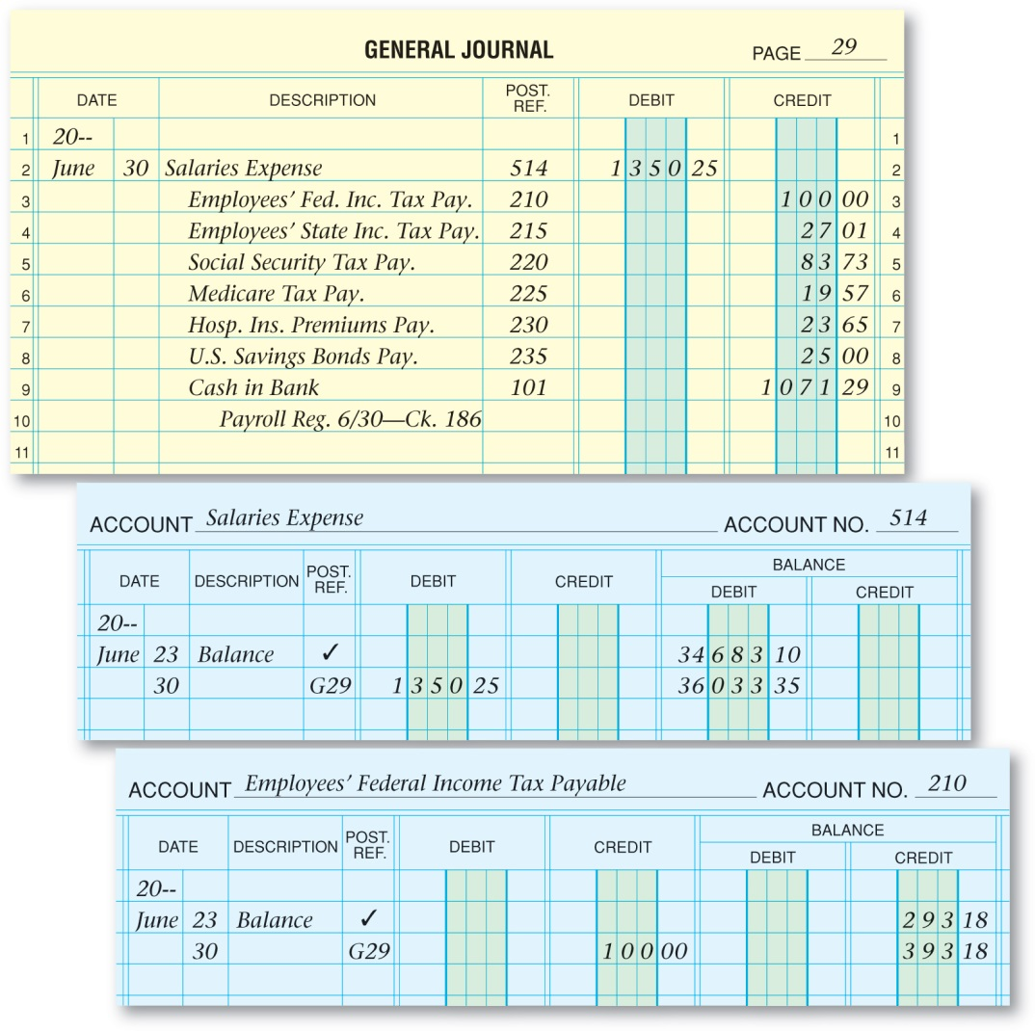
Posting the Payroll Entry
Section 13.1
Journalizing and Posting the Payroll
Home
See page 346

Slide 10
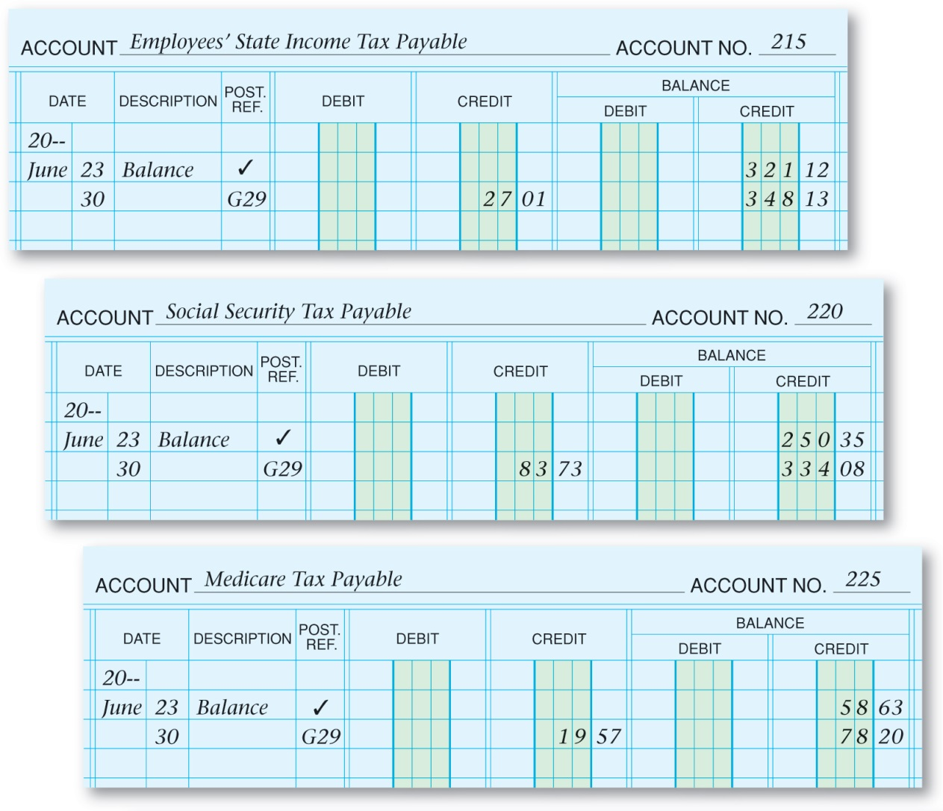
Posting the Payroll Entry
Section 13.1
Journalizing and Posting the Payroll
See page 347
Home

Slide 11
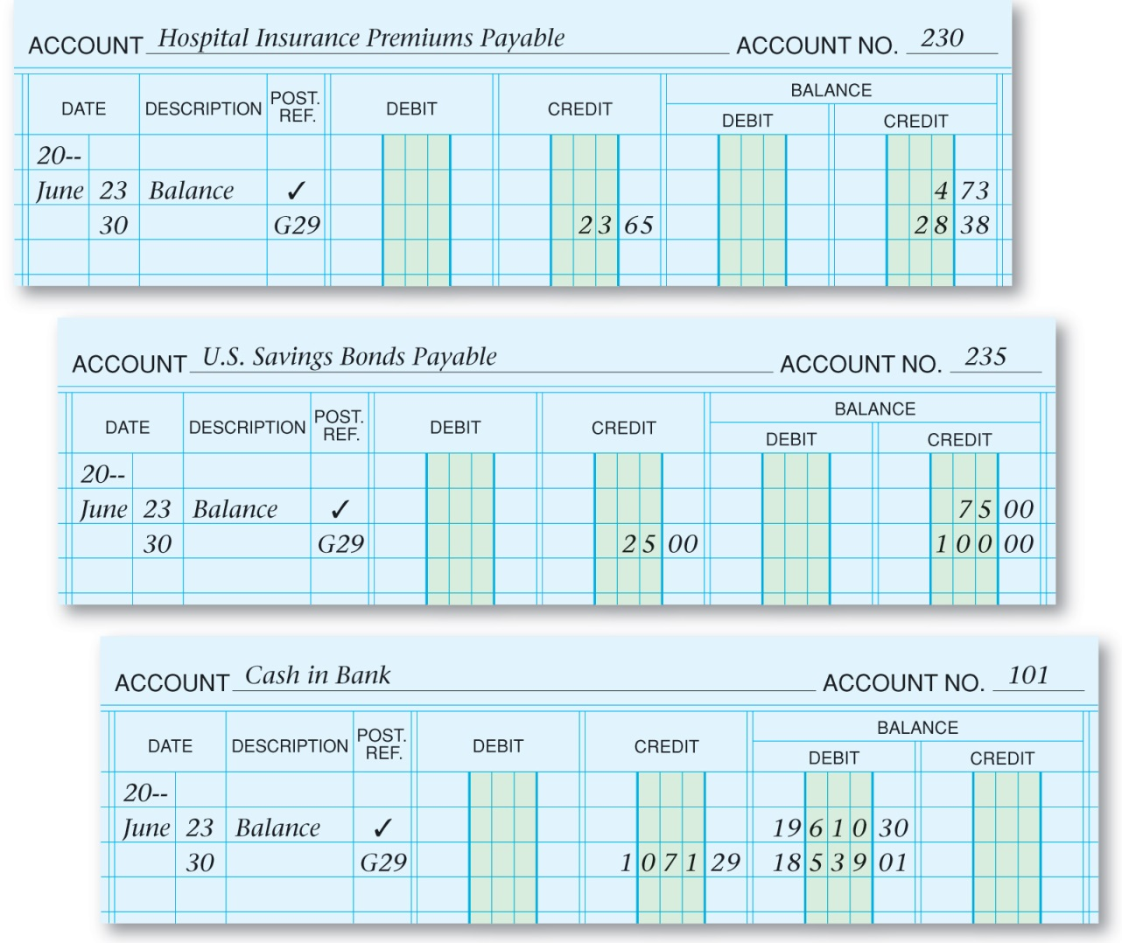
Posting the Payroll Entry
Section 13.1
Journalizing and Posting the Payroll
See page 347
Home

Slide 12
Section 13.2
Employer’s Payroll Taxes
Key Terms
Federal Unemployment Tax Act (FUTA)
State Unemployment Tax Act (SUTA)
unemployment taxes
Payroll Tax Expense
Home

Slide 13
Computing Payroll Tax Expenses
Section 13.2
Employer’s Payroll Taxes
Taxes on employees’ wages include:
Federal Unemployment Tax
State Unemployment Tax
Employer’s FICA Taxes
Home

Slide 14
Computing Payroll Tax Expenses
Section 13.2
Employer’s Payroll Taxes
Employees
Who pays FICA taxes?
Employers
6.2% for Social Security Tax
What are the current rates?
1.45% for Medicare Tax
Home

Slide 15
Computing Payroll Tax Expenses
Section 13.2
Employer’s Payroll Taxes
There are two unemployment laws that require employers to pay unemployment taxes:
Federal Unemployment Tax Act (FUTA)
State Unemployment Tax Act (SUTA)
unemployment taxes
Taxes collected to provide funds for workers who are temporarily out of work; usually paid only by the employer (FUTA and SUTA).
Home

Slide 16
Computing Payroll Tax Expenses
Section 13.2
Employer’s Payroll Taxes
There are two unemployment laws that require employers to pay unemployment taxes:
Federal Unemployment Tax Act (FUTA)
State Unemployment Tax Act (SUTA)
Federal Unemployment Tax Act (FUTA)
Law that requires employers to pay unemployment taxes to the federal government.
Home

Slide 17
Computing Payroll Tax Expenses
Section 13.2
Employer’s Payroll Taxes
There are two unemployment laws that require employers to pay unemployment taxes:
Federal Unemployment Tax Act (FUTA)
State Unemployment Tax Act (SUTA)
State Unemployment Tax Act (SUTA)
Law that requires employers to pay employment taxes to individual states.
Home

Slide 18
Journalizing the Employer’s Payroll Taxes
Section 13.2
Employer’s Payroll Taxes
The payroll taxes are recorded as business expenses in the Payroll Tax Expense account
Payroll Tax Expense
The expense account used to record the employer’s payroll taxes (FICA, FUTA, SUTA).
Home

Slide 19
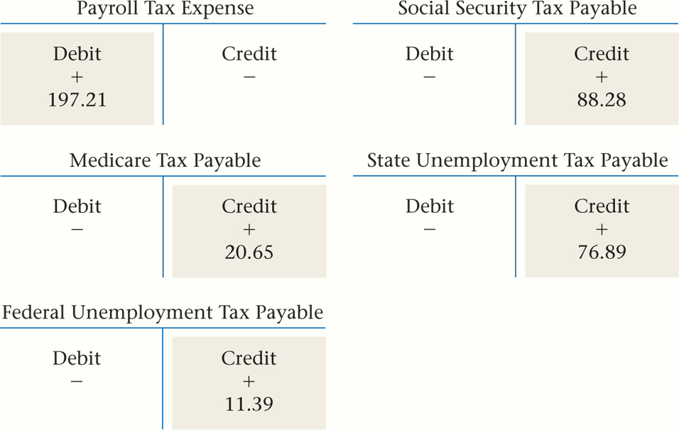
Journalizing the Employer’s Payroll Taxes
Section 13.2
Employer’s Payroll Taxes
Business Transaction
Zip’s payroll register in Figure 12-5 on page 323 is the source document for the payroll tax.
See page 351
Home

Slide 20
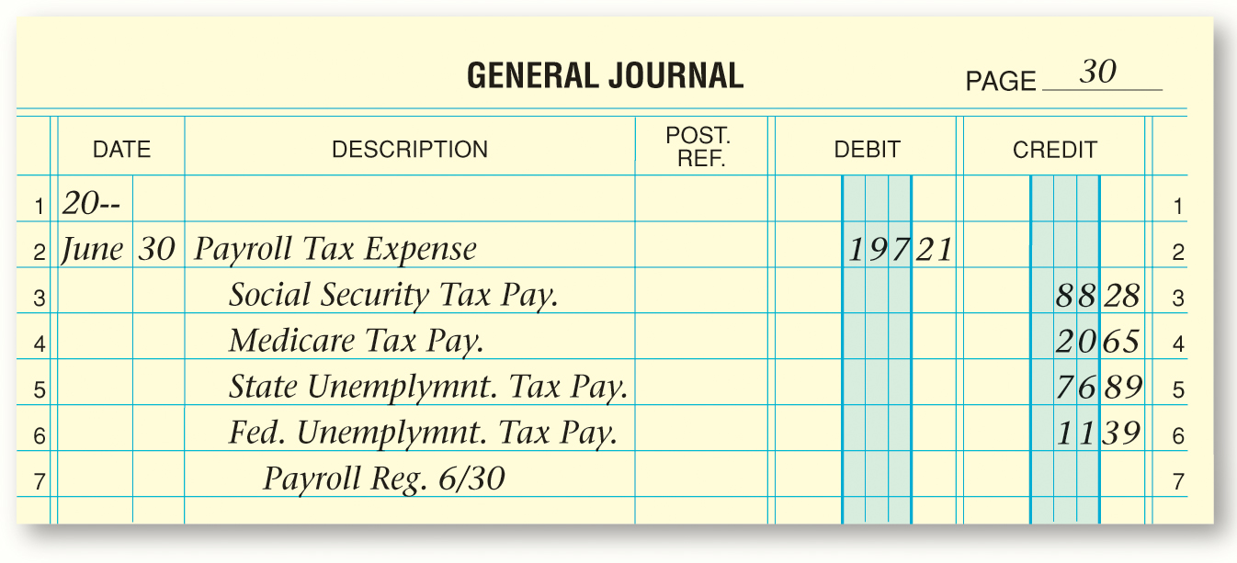
Journalizing the Employer Payroll Taxes
Section 13.2
Employer’s Payroll Taxes
Business Transaction
Zip’s payroll register in Figure 12-5 on page 323 is the source document for the payroll tax.
See page 351
Home

Slide 21
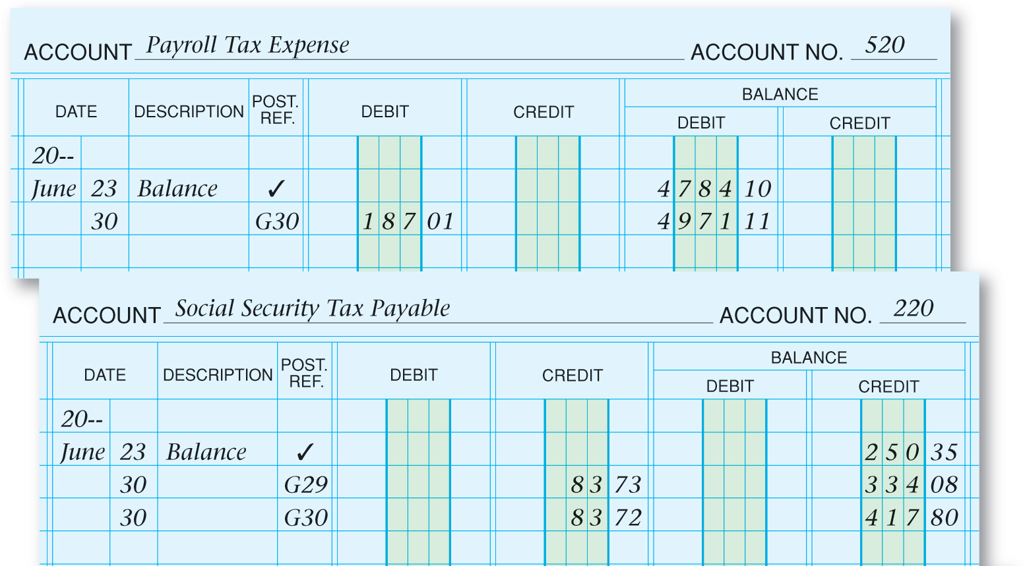
Posting Payroll Taxes to the General Ledger
Section 13.2
Employer’s Payroll Taxes
See page 352
Home

Slide 22
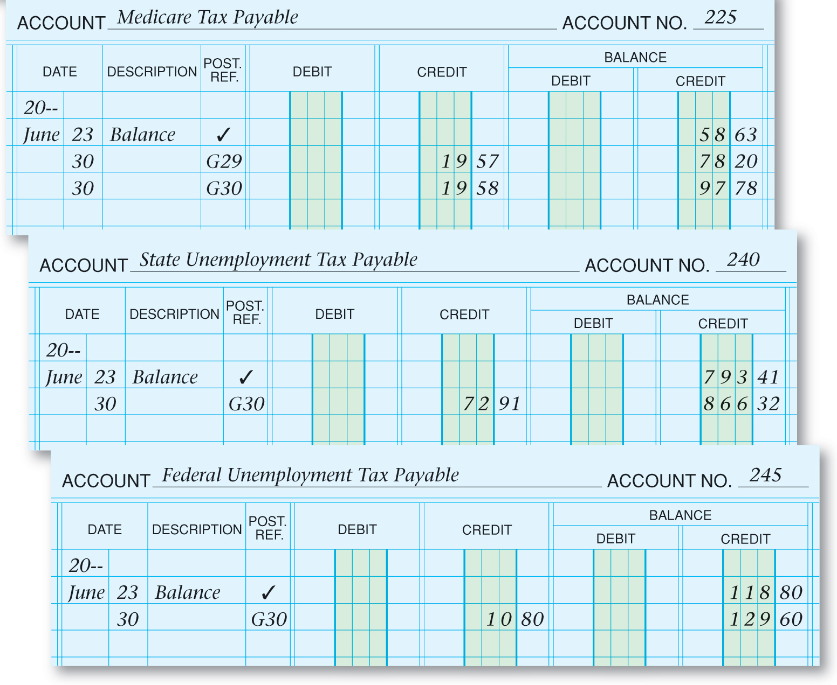
Posting Payroll Taxes to the General Ledger
Section 13.2
Employer’s Payroll Taxes
See page 352
Home

Slide 23
Section 13.3
Tax Liability Payments and Tax Reports
Key Terms
Form 8109
Electronic Federal Tax Payment System (EFTPS)
Form W-2
Form W-3
Form 941
Form 940
Home

Slide 24
Paying the Payroll Tax Liabilities
Section 13.3
Tax Liability Payments and Tax Reports
Social Security and Medicare Taxes
A business makes one payment combining:
Employees’ Federal Income Taxes Withheld
Home

Slide 25
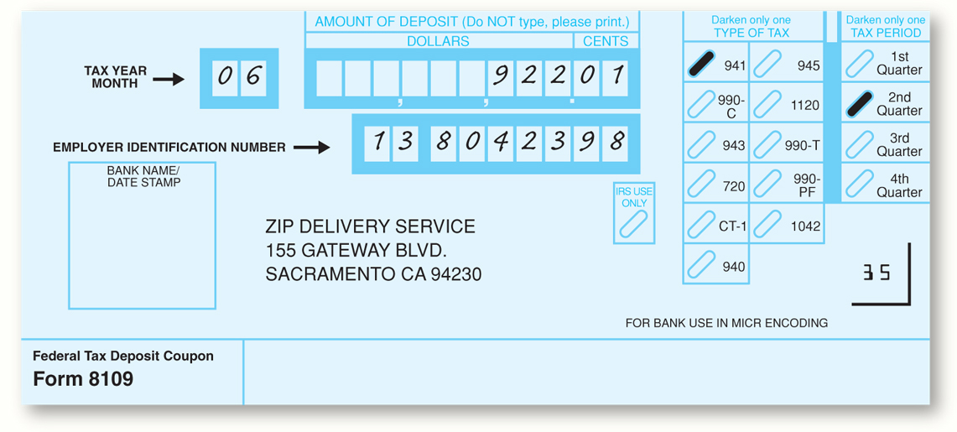
Paying the Payroll Tax Liabilities
Section 13.3
Tax Liability Payments and Tax Reports
Many small businesses prepare and send a Form 8109 with the check.
See page 354
Form 8109
Federal Deposit Tax Coupon; form sent with payment for FICA and federal income taxes or federal unemployment taxes.
Home

Slide 26
Paying the Payroll Tax Liabilities
Section 13.3
Tax Liability Payments and Tax Reports
The Electronic Federal Tax Payment System (EFTPS) is mostly used by larger businesses.
Electronic Federal Tax Payment System (EFTPS)
System used by large businesses to deposit tax payments by electronic funds transfer.
Home

Slide 27
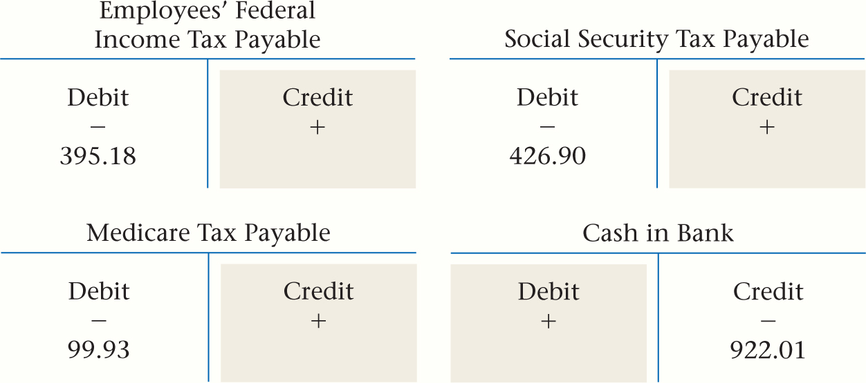
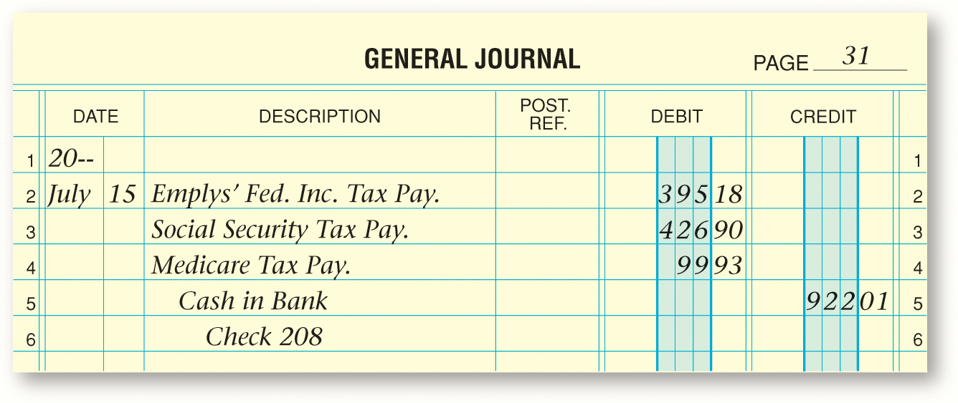
Paying the Payroll Tax Liabilities
Section 13.3
Tax Liability Payments and Tax Reports
Businesses pay FICA and federal income taxes withheld at regular intervals.
Business Transaction
Zip pays $922.01 payroll tax liabilities July 15 including $395.18 employees’ federal income taxes, $426.90 social security taxes, and $99.93 Medicare taxes.
Home
See pages 354–355

Slide 28
Paying the Payroll Tax Liabilities
Section 13.3
Tax Liability Payments and Tax Reports
Businesses pay state and local income taxes withheld at regular intervals.
Business Transaction
Zip pays $349.59 to the state. This is the amount of state income tax withheld from employees’ earnings, as indicated in the account shown in Figure 13-2.
Home
See pages 355–356

Slide 29
Paying the Payroll Tax Liabilities
Section 13.3
Tax Liability Payments and Tax Reports
Most businesses pay the FUTA tax quarterly, unless it is less than $100 and only an annual payment is needed.
Business Transaction
Zip pays $130.19 for FUTA taxes. This is the balance of the Federal Unemployment Tax Payable account shown in Figure 13-2.
Home
See pages 356–357

Slide 30
Paying the Payroll Tax Liabilities
Section 13.3
Tax Liability Payments and Tax Reports
State unemployment taxes are usually paid quarterly.
Business Transaction
Zip pays $870.30 to the state, as shown in Figure 13-2.
Home
See pages 357–358

Slide 31
Paying the Payroll Tax Liabilities
Section 13.3
Tax Liability Payments and Tax Reports
Payments for voluntary deductions are also made.
Business Transaction
On July 15 Zip pays $28.38 for hospital insurance premiums (Refer to Figure 13-1).
Home
See page 358

Slide 32
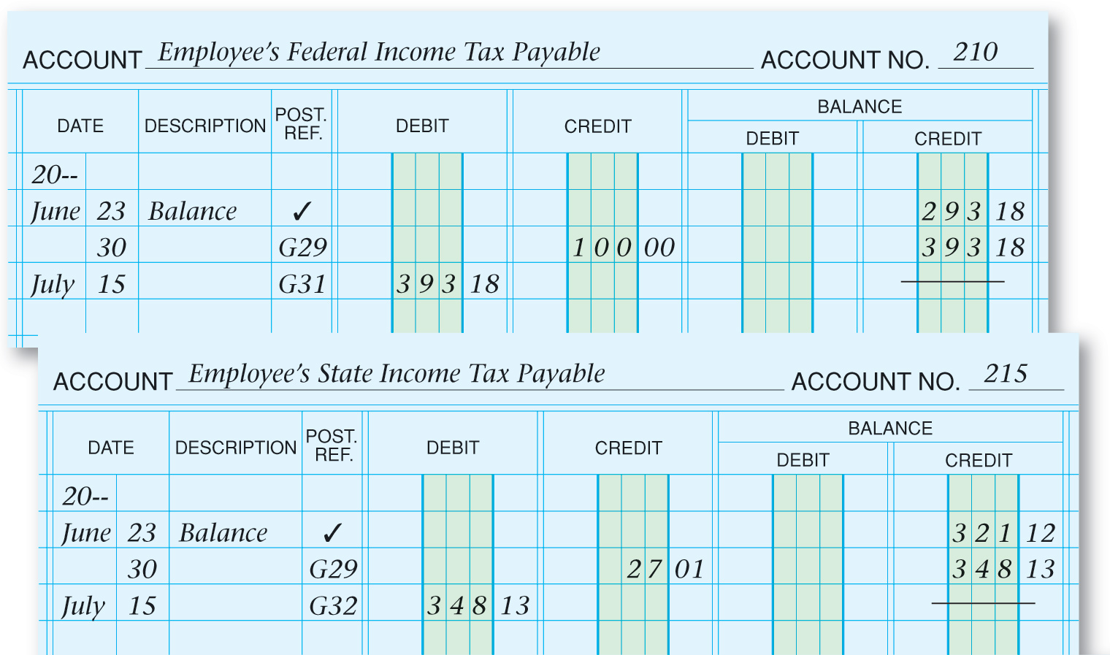
Paying the Payroll Tax Liabilities
Section 13.3
Tax Liability Payments and Tax Reports
Posting the Payment of Payroll Liabilities
See page 359
Home

Slide 33
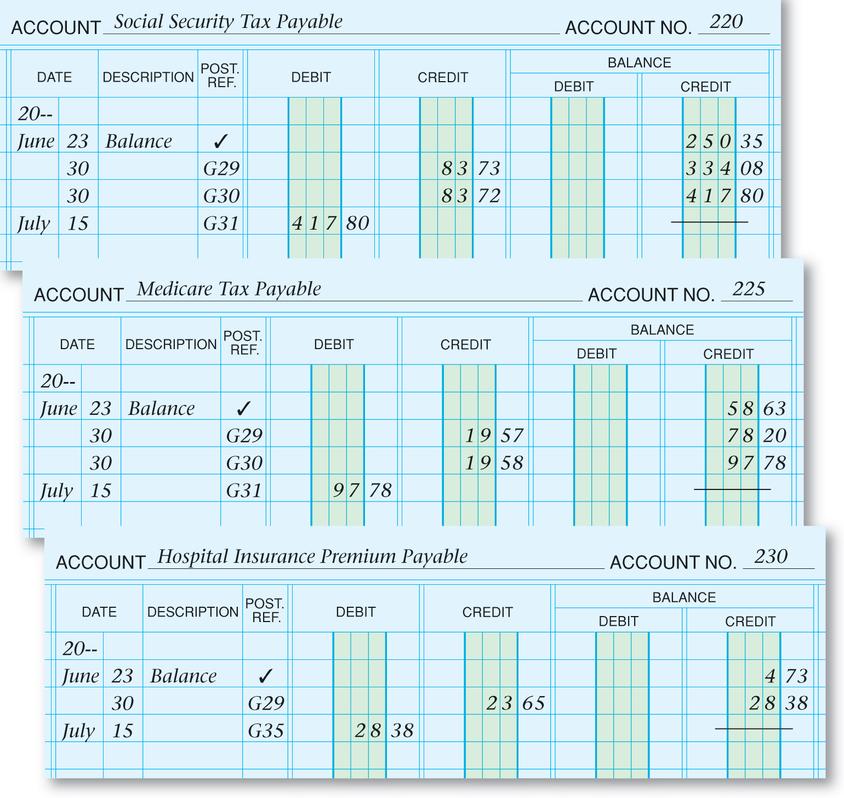
Paying the Payroll Tax Liabilities
Section 13.3
Tax Liability Payments and Tax Reports
Posting the Payment of Payroll Liabilities
See page 359
Home

Slide 34
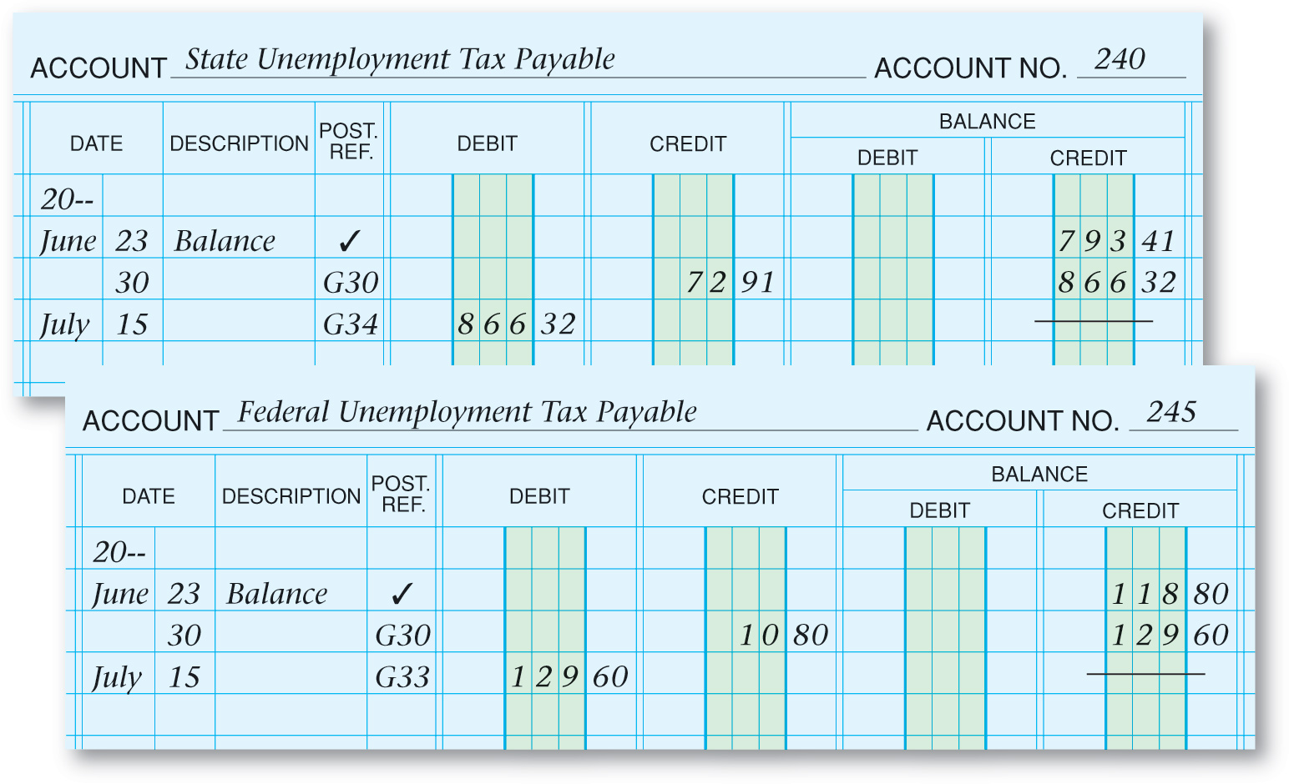
Paying the Payroll Tax Liabilities
Section 13.3
Tax Liability Payments and Tax Reports
Posting the Payment of Payroll Liabilities
See page 360
Home

Slide 35
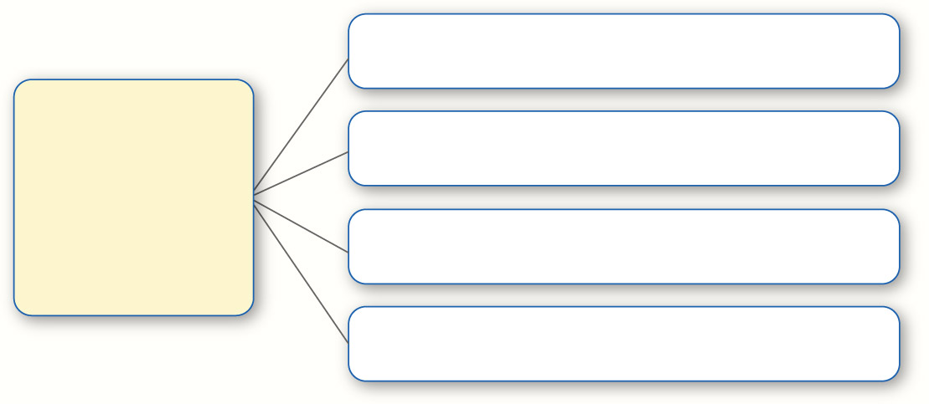
Preparing Payroll Tax Forms
Section 13.3
Tax Liability Payments and Tax Reports
Form W-2
Filed Annually
Payroll-Related Tax Forms
Form W-3
Filed Annually
Form 941
Filed Quarterly
Form 940
Filed Annually
Form W-2
Wage and Tax Statement; form that summarizes an employee’s earnings and amounts withheld for federal, state, and local taxes.
Home

Slide 36
Preparing Payroll Tax Forms
Section 13.3
Tax Liability Payments and Tax Reports
Form W-2
Filed Annually
Payroll-Related Tax Forms
Form W-3
Filed Annually
Form 941
Filed Quarterly
Form 940
Filed Annually
Form W-3
Transmittal of Wage and Tax Statements; summarizes the information contained on the employees’ Forms W-2 and accompanies the Forms W-2 sent to the federal government.
Home

Slide 37
Preparing Payroll Tax Forms
Section 13.3
Tax Liability Payments and Tax Reports
Form W-2
Filed Annually
Payroll-Related Tax Forms
Form W-3
Filed Annually
Form 941
Filed Quarterly
Form 940
Filed Annually
Form 941
Employer’s Quarterly Federal Tax Return; form used to report accumulated amounts of FICA and federal income tax withheld from employees’ earnings for the quarter, as well as FICA tax owed by the employer.
Home

Slide 38
Preparing Payroll Tax Forms
Section 13.3
Tax Liability Payments and Tax Reports
Form W-2
Filed Annually
Payroll-Related Tax Forms
Form W-3
Filed Annually
Form 941
Filed Quarterly
Form 940
Filed Annually
Form 940
Form that reports the employer’s federal unemployment taxes.
Home

Slide 39
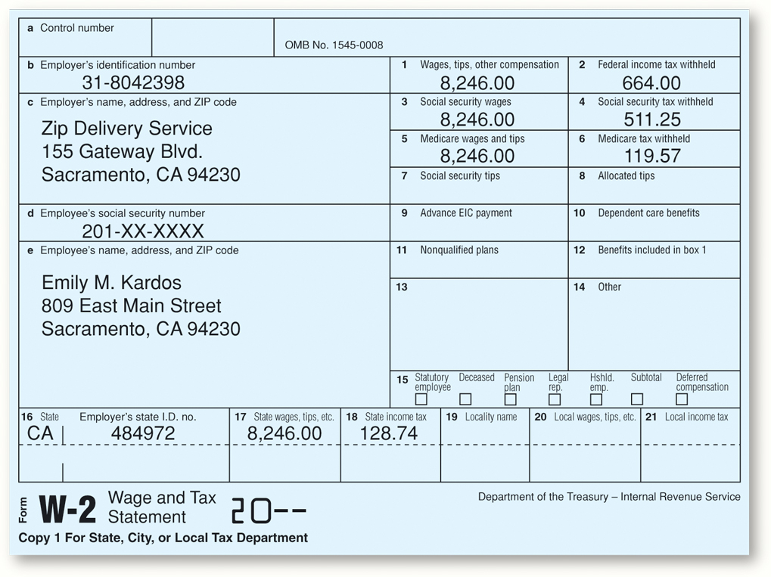
Preparing Payroll Tax Forms
Section 13.3
Tax Liability Payments and Tax Reports
Home
See page 361

Slide 40
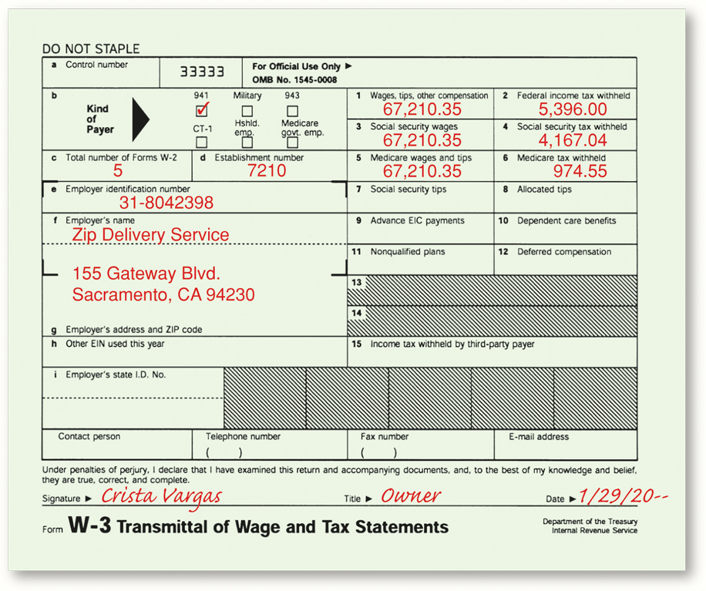
Preparing Payroll Tax Forms
Section 13.3
Tax Liability Payments and Tax Reports
Home
See page 361

Slide 41
Question 1
Mandy’s Dance Studio had a payroll that had $2,565.78 in gross pay. Calculate the employer’s payroll taxes (assume that no employee has reached the maximum for social security deductions or for state or federal unemployment tax).
Step 1: Calculate the social security tax by multiplying gross wages by 6.2 percent ($2,565.78 x .062 = $159.08).
Step 2: Calculate the Medicare tax by multiplying gross wages by 1.45 percent ($2,565.78 x .0145 = $37.20).
Step 3: Calculate the state unemployment tax by multiplying gross wages by 5.4 percent ($2,565.78 x .054 = $138.55).
Step 4: Calculate the federal unemployment tax by multiplying gross wages by 0.8 percent ($2,565.78 x .008 = $20.53)
Home

Slide 42
Question 2
Which payroll-related forms discussed in the chapter must a business file with the government?
W-2 Wage and Tax Statement
W-3 Transmittal of Wage and Tax Statements
941 Employer’s Quarterly Federal Tax Return
940 Employer’s Annual Federal Unemployment (FUTA) Tax Return
Home

Slide 43
End of
Home

