Slide 1
Home

Slide 2
Revenues, expenses, and withdrawals are temporary accounts. Double-entry accounting requires that total debit and total credits are always equal.
Home
Glencoe Accounting
Copyright © by The McGraw-Hill Companies, Inc. All rights reserved.

Slide 3
Explain the difference between permanent accounts and temporary accounts.
List and apply the rules of debit and credit for revenue, expense, and withdrawals accounts.
Use the six-step method to analyze transactions affecting revenue, expense, and withdrawals accounts.
Test a series of transactions for equality of debits and credits.
Home
Glencoe Accounting
Copyright © by The McGraw-Hill Companies, Inc. All rights reserved.

Slide 4
Section 5.1
Relationship of Revenue, Expenses, and Withdrawals to Owner’s Equity
Key Terms
temporary accounts
permanent accounts
Home

Slide 5
Temporary and Permanent Accounts
Section 5.1
Relationship of Revenue, Expenses, and Withdrawals to Owner’s Equity
Revenues, expenses, and withdrawals could be recorded as increases or decreases in the capital account.
A better way to record these transactions is to set up separate accounts for each type of revenue or expense.
Home

Slide 6
Temporary and Permanent Accounts
Section 5.1
Relationship of Revenue, Expenses, and Withdrawals to Owner’s Equity
Temporary Accounts
Start the accounting period with a zero balance.
Accumulate amounts for one accounting period.
Transfer the balance to the owner’s capital account at the end of the period.
temporary accounts
Accounts used to collect information that will be transferred to permanent capital accounts at the end of the accounting period.
Home

Slide 7
Temporary and Permanent Accounts
Section 5.1
Relationship of Revenue, Expenses, and Withdrawals to Owner’s Equity
The balances on hand or amounts owed at any time
Permanent
Accounts show:
The day-to-day account changes
permanent accounts
Accounts that are continuous from one accounting period to the next; balances are carried forward to the next period.
Home

Slide 8
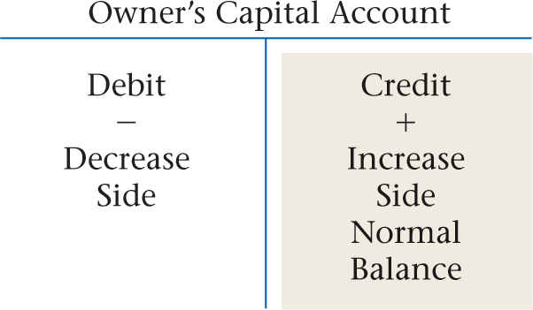
The Rules of Debit and Credit for Temporary Accounts
Section 5.1
Relationship of Revenue, Expenses, and Withdrawals to Owner’s Equity
Review the T account showing the rules of debit and credit for the owner’s capital account:
Home

Slide 9
The Rules of Debit and Credit for Temporary Accounts
Section 5.1
Relationship of Revenue, Expenses, and Withdrawals to Owner’s Equity
These rules of debit and credit are used for revenue accounts:
An expense account is increased on the debit side.
An expense account is decreased on the credit side.
The normal balance for an expense account is the increase or the debit side. Expense accounts normally have debit balances.
Home

Slide 10
The Rules of Debit and Credit for Temporary Accounts
Section 5.1
Relationship of Revenue, Expenses, and Withdrawals to Owner’s Equity
See page 110
Home

Slide 11
The Rules of Debit and Credit for Temporary Accounts
Section 5.1
Relationship of Revenue, Expenses, and Withdrawals to Owner’s Equity
These rules of debit and credit are used for expense accounts:
An expense account is increased on the debit side.
An expense account is decreased on the credit side.
The normal balance for an expense account is the increase or the debit side. Expense accounts normally have debit balances.
Home

Slide 12
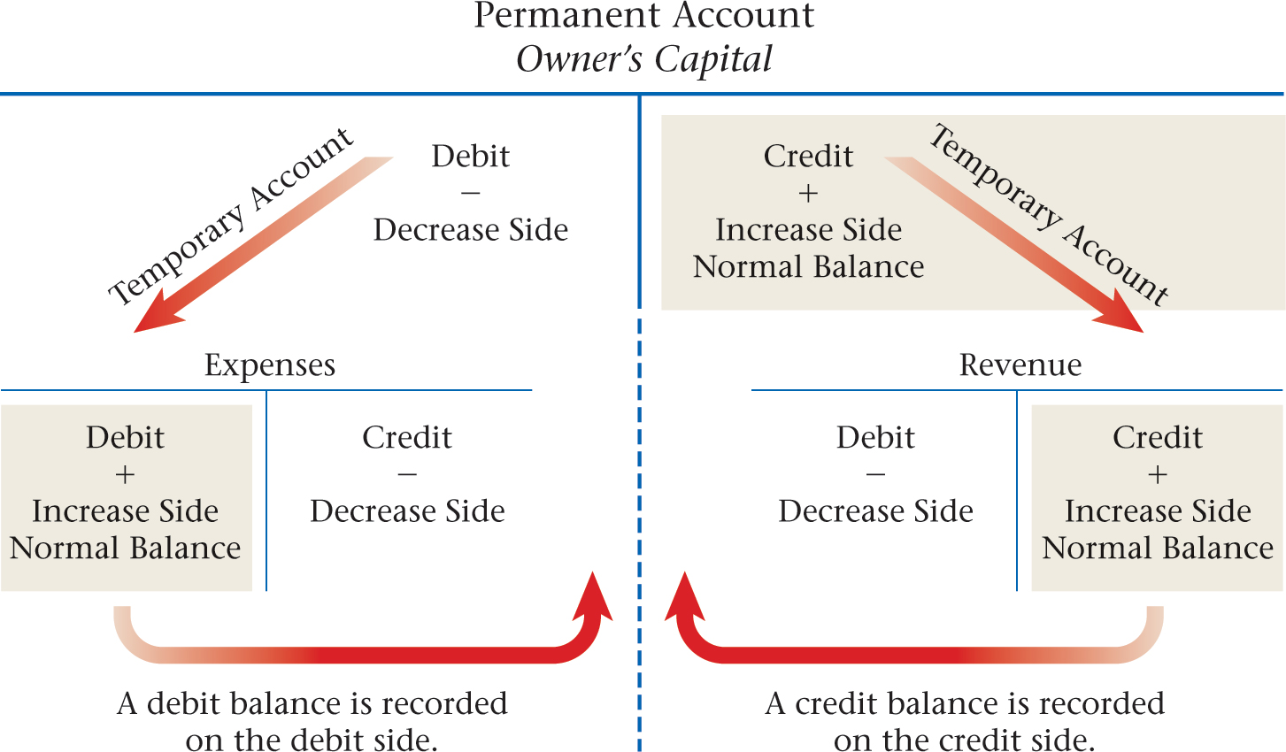
The Rules of Debit and Credit for Temporary Accounts
Section 5.1
Relationship of Revenue, Expenses, and Withdrawals to Owner’s Equity
See page 111
Home

Slide 13
The Rules of Debit and Credit for Temporary Accounts
Section 5.1
Relationship of Revenue, Expenses, and Withdrawals to Owner’s Equity
These rules of debit and credit are used for withdrawals accounts:
A withdrawals account is increased on the debit side.
A withdrawals account is decreased on the credit side.
The normal balance for a withdrawals account is the increase or the debit side. Withdrawals accounts normally have debit balances.
Home

Slide 14
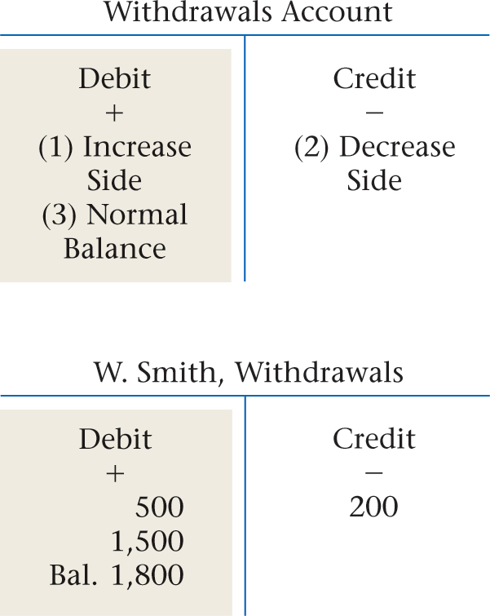
The Rules of Debit and Credit for Temporary Accounts
Section 5.1
Relationship of Revenue, Expenses, and Withdrawals to Owner’s Equity
Home

Slide 15
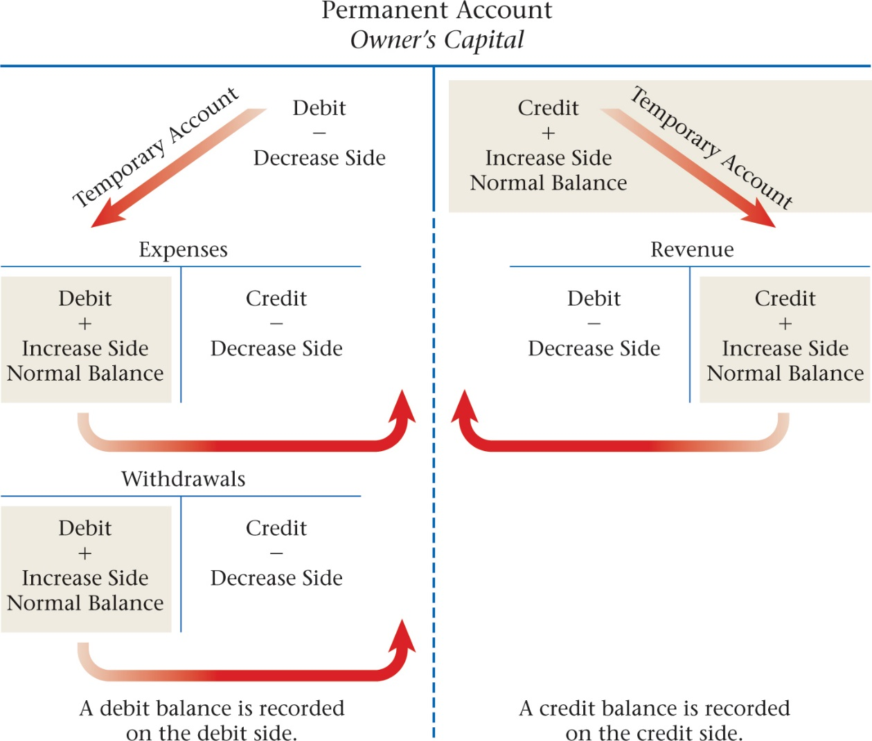
The Rules of Debit and Credit for Temporary Accounts
Section 5.1
Relationship of Revenue, Expenses, and Withdrawals to Owner’s Equity
See page 112
Home

Slide 16
Section 5.2
Applying the Rules of Debit and Credit to Revenue, Expense, and Withdrawals Transactions
Key Term
revenue recognition
Home

Slide 17
Analyzing Transactions
Section 5.2
Applying the Rules of Debit and Credit to Revenue, Expense, and Withdrawals Transactions
Using the rules of debit and credit, analyze some business transactions that affect revenue, expense, and owner’s withdrawals accounts.
Business Transaction 8
On October 15 Zip provided delivery services for Sims Corporation. A check for $1,200 was received in full payment.
See page 114
Home

Slide 18
Analyzing Transactions
Section 5.2
Applying the Rules of Debit and Credit to Revenue, Expense, and Withdrawals Transactions
Using the rules of debit and credit, analyze some business transactions that affect revenue, expense, and owner’s withdrawals accounts.
Business Transaction 9
On October 16 Zip mailed Check 103 for $700 to pay the month’s rent.
See page 115
Home

Slide 19
Analyzing Transactions
Section 5.2
Applying the Rules of Debit and Credit to Revenue, Expense, and Withdrawals Transactions
Using the rules of debit and credit, analyze some business transactions that affect revenue, expense, and owner’s withdrawals accounts.
Business Transaction 10
On October 18 Rockport Advertising prepared an advertisement for Zip. Zip will pay Rockport’s $75 fee later.
See page 115
Home

Slide 20
Analyzing Transactions
Section 5.2
Applying the Rules of Debit and Credit to Revenue, Expense, and Withdrawals Transactions
Using the rules of debit and credit, analyze some business transactions that affect revenue, expense, and owner’s withdrawals accounts.
This transaction follows the GAAP principle of revenue recognition.
Business Transaction 11
On October 20 Zip billed City News $1,450 for delivery services.
See page 116
revenue recognition
The GAAP principle that revenue is recorded on the date it is earned even if cash has not been received.
Home

Slide 21
Analyzing Transactions
Section 5.2
Applying the Rules of Debit and Credit to Revenue, Expense, and Withdrawals Transactions
Using the rules of debit and credit, analyze some business transactions that affect revenue, expense, and owner’s withdrawals accounts.
Business Transaction 12
On October 28 Zip paid a $125 telephone bill with Check 104.
See page 116
Home

Slide 22
Analyzing Transactions
Section 5.2
Applying the Rules of Debit and Credit to Revenue, Expense, and Withdrawals Transactions
Using the rules of debit and credit, analyze some business transactions that affect revenue, expense, and owner’s withdrawals accounts.
Business Transaction 13
On October 29 Zip wrote Check 105 for $600 to have the office repainted.
See page 117
Home

Slide 23
Analyzing Transactions
Section 5.2
Applying the Rules of Debit and Credit to Revenue, Expense, and Withdrawals Transactions
Using the rules of debit and credit, analyze some business transactions that affect revenue, expense, and owner’s withdrawals accounts.
Business Transaction 14
On October 30 Zip wrote Check 106 for $500 as their draw for the month.
See page 117
Home

Slide 24
Testing for the Equality of Debits and Credits
Section 5.2
Applying the Rules of Debit and Credit to Revenue, Expense, and Withdrawals Transactions
Steps for testing for the equality of debits and credits:
Make a list of account names.
Next to each account, list the account balance in either the debit or credit column.
Add the amounts in each column.
Home

Slide 25
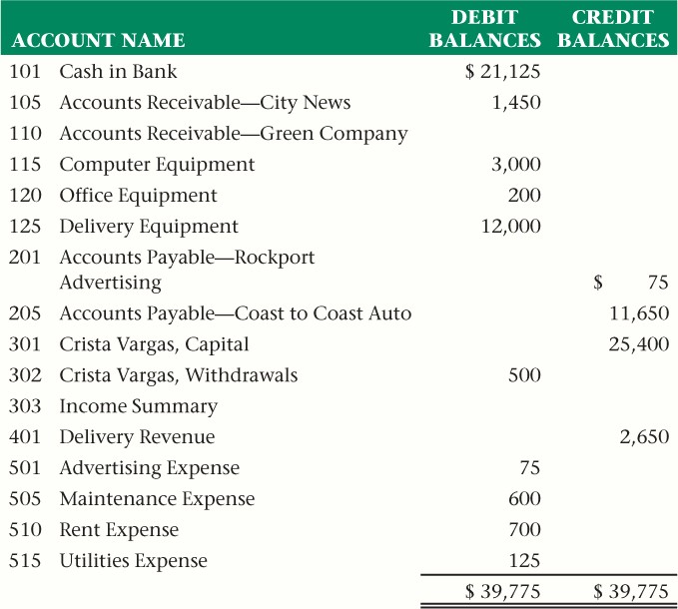
Testing for the Equality of Debits and Credits
Section 5.2
Applying the Rules of Debit and Credit to Revenue, Expense, and Withdrawals Transactions
Home
See page 118

Slide 26
Question 1
On October 24 Larry Nevers, the owner of Aqua Pool, took $1,000 out of the business for personal use. Using the Business Transaction Analysis method, list the steps you would use to record this transaction. Assume that accounts for Cash in Bank and Larry Nevers, Withdrawals exist.
Step 1: Identify the accounts affected.
The accounts Larry Nevers, Withdrawals and Cash in Bank are affected.
(continued)
Home

Slide 27
Question 1
On October 24 Larry Nevers, the owner of Aqua Pool, took $1,000 out of the business for personal use. Using the Business Transaction Analysis method, list the steps you would use to record this transaction. Assume that accounts for Cash in Bank and Larry Nevers, Withdrawals exist.
Step 2: Classify the accounts affected.
Larry Nevers, Withdrawals is an owner’s equity account. Cash in Bank is an asset account.
(continued)
Home

Slide 28
Question 1
On October 24 Larry Nevers, the owner of Aqua Pool, took $1,000 out of the business for personal use. Using the Business Transaction Analysis method, list the steps you would use to record this transaction. Assume that accounts for Cash in Bank and Larry Nevers, Withdrawals exist.
Step 3: Determine the amount of increase or decrease for each account affected.
Larry Nevers, Withdrawals is increased by $1,000. Cash in Bank is decreased by $1,000.
(continued)
Home

Slide 29
Question 1
On October 24 Larry Nevers, the owner of Aqua Pool, took $1,000 out of the business for personal use. Using the Business Transaction Analysis method, list the steps you would use to record this transaction. Assume that accounts for Cash in Bank and Larry Nevers, Withdrawals exist.
Step 4: Which account is debited and for what amount?
Increases in the owner’s withdrawal account are recorded as debits. Debit Larry Nevers, Withdrawals for $1,000.
(continued)
Home

Slide 30
Question 1
On October 24 Larry Nevers, the owner of Aqua Pool, took $1,000 out of the business for personal use. Using the Business Transaction Analysis method, list the steps you would use to record this transaction. Assume that accounts for Cash in Bank and Larry Nevers, Withdrawals exist.
Step 5: Which account is credited and for what amount?
Decreases in asset accounts are recorded as credits. Credit Cash in Bank for $1,000.
Home

Slide 31
Question 2
Why do expense accounts have a normal debit balance if they are temporary capital accounts, and why do owner’s capital accounts, which are permanent accounts, have a credit balance?
Expenses are the cost of doing business and therefore as expenses increase, owner’s equity decreases. Owner’s capital accounts decrease with a debit; therefore, increases in expenses are recorded as debits.
Home

Slide 32
End of
Home

