Slide 1
Home

Slide 2
The accounting cycle is a series of steps done in each accounting period to keep records in an orderly fashion. You can use the general journal to record all of the transactions of a business.
Home
Glencoe Accounting
Copyright © by The McGraw-Hill Companies, Inc. All rights reserved.

Slide 3
Explain the first three steps in the accounting cycle.
Give and describe several examples of source documents.
Explain the purpose of journalizing.
Apply information from source documents.
Describe the steps to make a general journal entry.
Make general journal entries.
Correct errors in general journal entries.
Home
Glencoe Accounting
Copyright © by The McGraw-Hill Companies, Inc. All rights reserved.

Slide 4
Section 6.1
The Accounting Cycle
Key Terms
accounting cycle
source document
invoice
receipt
memorandum
check stub
journal
journalizing
fiscal year
calendar year
Home

Slide 5
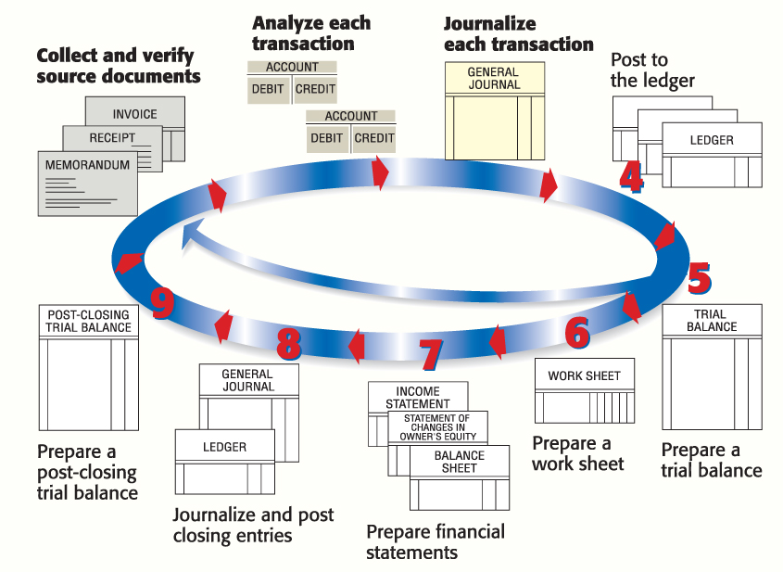
The Steps of the Accounting Cycle
Section 6.1
The Accounting Cycle
The Accounting Cycle
accounting cycle
Activities performed in an accounting period that help the business keep its records in an orderly fashion.
Home

Slide 6
The Steps of the Accounting Cycle
Section 6.1
The Accounting Cycle
Step 1
Step 2
Step 3
Collect and verify source documents.
Analyze each transaction.
Journalize each transaction.
Home

Slide 7
The Steps of the Accounting Cycle
Section 6.1
The Accounting Cycle
Commonly Used Source Documents
Invoice
Receipt
Memorandum
Check stub
source document
A paper prepared as the evidence that a transaction occurred.
Home

Slide 8
The Steps of the Accounting Cycle
Section 6.1
The Accounting Cycle
Commonly Used Source Documents
Invoice
Receipt
Memorandum
Check stub
invoice
A source document that lists the quantity, description, unit price, and total cost of the items sold and shipped to a buyer.
Home

Slide 9
The Steps of the Accounting Cycle
Section 6.1
The Accounting Cycle
Commonly Used Source Documents
Invoice
Receipt
Memorandum
Check stub
receipt
A source document that serves as a record of cash received.
Home

Slide 10
The Steps of the Accounting Cycle
Section 6.1
The Accounting Cycle
Commonly Used Source Documents
Invoice
Receipt
Memorandum
Check stub
memorandum
A brief written message that describes a transaction that takes place within a business.
Home

Slide 11
The Steps of the Accounting Cycle
Section 6.1
The Accounting Cycle
Commonly Used Source Documents
Invoice
Receipt
Memorandum
Check stub
check stub
A source document that lists the same information that appears on a check and shows the balance in the checking account before and after each check is written.
Home

Slide 12
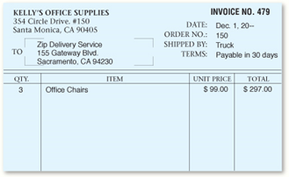
The Steps of the Accounting Cycle
Section 6.1
The Accounting Cycle
Invoice
See page 136
Home

Slide 13
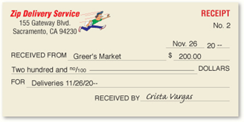
The Steps of the Accounting Cycle
Section 6.1
The Accounting Cycle
Receipt
See page 136
Home

Slide 14
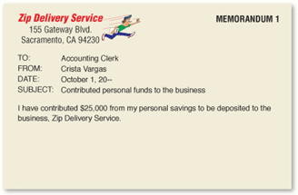
The Steps of the Accounting Cycle
Section 6.1
The Accounting Cycle
Memo
See page 136
Home

Slide 15
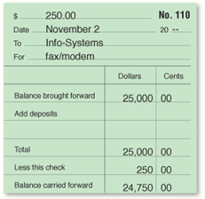
The Steps of the Accounting Cycle
Section 6.1
The Accounting Cycle
Check Stub
See page 136
Home

Slide 16
The Steps of the Accounting Cycle
Section 6.1
The Accounting Cycle
Step 1
Step 2
Step 3
Collect and verify source documents.
Analyze each transaction.
Journalize each transaction.
Determine the debit and credit portions of each transaction by analyzing the source document.
In the real world, you must examine this document to determine what happened in a business transaction.
Home

Slide 17
The Steps of the Accounting Cycle
Section 6.1
The Accounting Cycle
Step 1
Step 2
Step 3
Collect and verify source documents.
Analyze each transaction.
Transactions are entered into a journal. This is journalizing.
journal
A chronological record of the transactions of a business.
journalizing
The process of recording business transactions.
Home

Slide 18
The Accounting Period
Section 6.1
The Accounting Cycle
A fiscal year is not the same as a calendar year.
fiscal year
An accounting period of twelve months.
calendar year
Accounting period that begins on January 1 and ends on December 31.
Home

Slide 19
Section 6.2
Recording Transactions in the General Journal
Key Term
general journal
Home

Slide 20
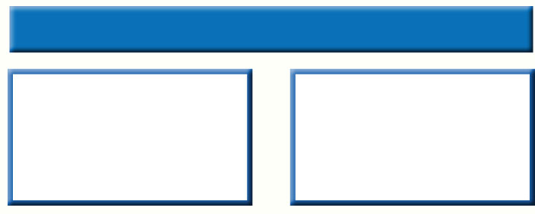
Recording a General Journal Entry
Section 6.2
Recording Transactions in the General Journal
Two Columns of the General Journal
The left column for recording debits
The right column for recording credits
general journal
An all-purpose journal in which all the transactions of a business may be recorded.
Home

Slide 21
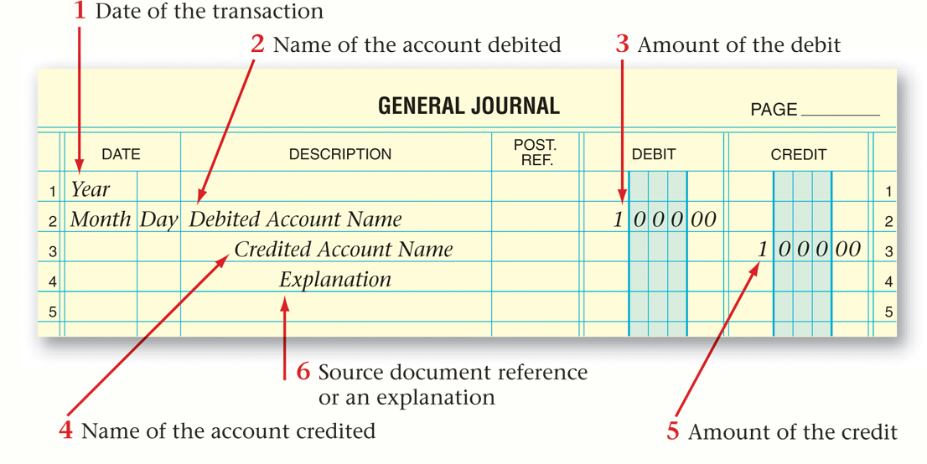
Recording a General Journal Entry
Section 6.2
Recording Transactions in the General Journal
See page 139
Home

Slide 22
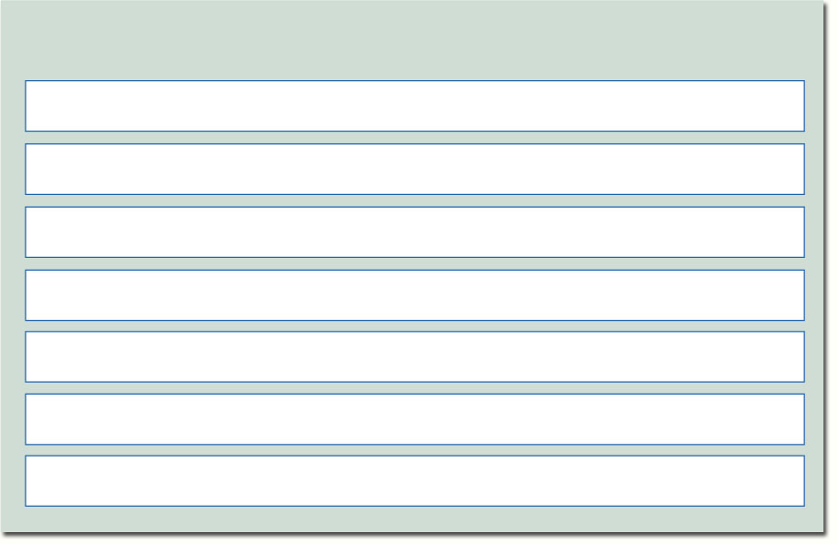
Recording a General Journal Entry
Section 6.2
Recording Transactions in the General Journal
Seven steps to determining each journal entry
Identify the accounts affected.
Classify the accounts affected.
Determine the amount of increase or decrease for each account affected.
Determine which accounts are debited and for what amount.
Determine which accounts are credited and for what amount.
Determine the complete entry in T-account form.
Determine the complete entry in general journal entry form.
Home

Slide 23
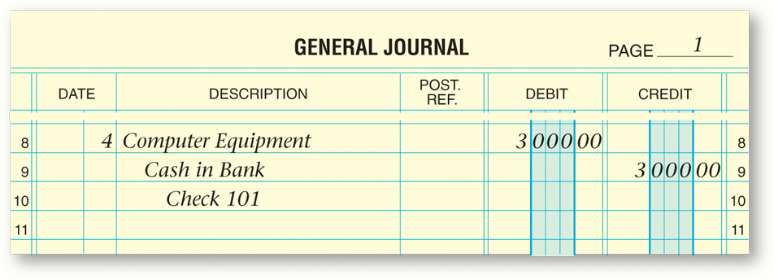
Recording a General Journal Entry
Section 6.2
Recording Transactions in the General Journal
Here is an example showing the analysis of a business transaction and its general journal entry:
Business Transaction
Zip issued a $3,000 check to purchase a computer system.
See page 142
Home

Slide 24
Recording a General Journal Entry
Section 6.2
Recording Transactions in the General Journal
Do not erase an error. Draw a line through it with a pen and enter the correct information above the line.
Business Transaction
See page 151
Home

Slide 25
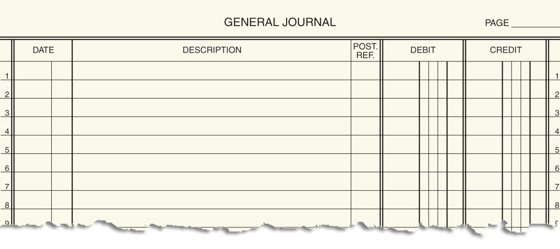
Question 1
Describe the general journal entry for the following event.
On January 16, 20-- On Time Delivery issued Check 243 to Comfort Space for $4,000 to buy office furniture.
20--
Office Furniture
Jan.
16
4 0 0 0 00
Cash in Bank
4 0 0 0 00
Check 243
(continued)
Home

Slide 26
Question 1
First record the date in the Date Column.
20--
Jan.
16
(continued)
Home

Slide 27
Question 1
Then record:
the account debited in the Description column.
the amount of the debit in the Debit column.
20--
Office Furniture
Jan.
16
4 0 0 0 00
(continued)
Home

Slide 28
Question 1
Then record:
the account credited in the Description column. The account name is indented under the debit account name.
the amount of the credit in the Credit Column.
20--
Office Furniture
Jan.
16
4 0 0 0 00
Cash in Bank
4 0 0 0 00
(continued)
Home

Slide 29
Question 1
Finally, in the Description column, record:
an explanation. Indent the explanation under the credit account name.
20--
Office Furniture
Jan.
16
4 0 0 0 00
Cash in Bank
4 0 0 0 00
Check 243
Home

Slide 30
Question 2
Why do businesses separate their accounting records into accounting periods?
Businesses use accounting periods to make financial comparisons possible. Comparisons of business performance would be impossible if fiscal periods varied in length.
Home

Slide 31
End of
Home

