Slide 1
Home

Slide 2
The general journal is a permanent record organized by account number. Posting is the process of transferring information from the journal to individual accounts in the ledger. The trial balance is a proof that total debits equal total credits in the ledger.
Home
Glencoe Accounting
Copyright © by The McGraw-Hill Companies, Inc. All rights reserved.

Slide 3
Explain the purpose of the general ledger.
Describe the steps in the posting process.
Post general journal entries.
Prepare a trial balance.
Locate and correct trial balance errors.
Record correcting entries in the general journal.
Home
Glencoe Accounting
Copyright © by The McGraw-Hill Companies, Inc. All rights reserved.

Slide 4
Section 7.1
The General Ledger
Key Terms
posting
general ledger
ledger account forms
Home

Slide 5
Setting Up the General Ledger
Section 7.1
The General Ledger
This creates a record of the impact of business transactions on each account used by a business.
Accounts used by a business are kept on separate pages or cards in a book or file called a ledger. It is important for a number of reasons:
It also helps managers easily find the current balance of a specific account.
Home

Slide 6
Setting Up the General Ledger
Section 7.1
The General Ledger
Posting is the process by which random transactions become organized in a manner according to accounts.
posting
The process of transferring information from the journal to individual general ledger accounts.
Home

Slide 7
Setting Up the General Ledger
Section 7.1
The General Ledger
The general ledger provides up-to-date balances for each account, including accounts payable and receivable.
In a computerized system, electronic files are still referred to as a ledger, or the ledger accounts.
Managers use ledgers to obtain summarized information.
general ledger
A permanent record organized by account number.
Home

Slide 8
Setting Up the General Ledger
Section 7.1
The General Ledger
Ledger Account Forms
The forms are defined by the number of columns into which a dollar amount goes.
Debit and credit amounts are posted from journal entries to the first two amount columns.
The new account balance is entered in one of the last two amount columns.
The type of account determines which balance column to use.
ledger account forms
The accounting stationery used to record financial information about specific accounts.
Home

Slide 9
Setting Up the General Ledger
Section 7.1
The General Ledger
The Four-Column Ledger Account Form
See page 168
Home

Slide 10
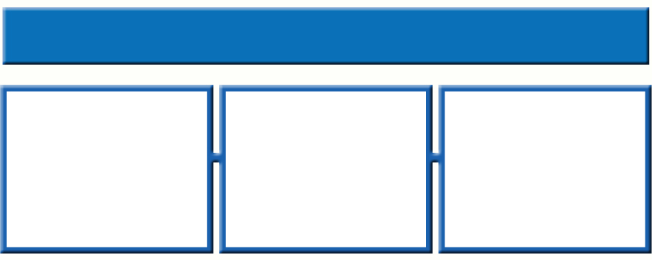
The Fourth Step in the Accounting Cycle: Posting
Section 7.2
The Posting Process
Posting shows the final impact on an account, which is why a ledger is sometimes called a book of final entry.
Posting intervals are determined by the size of the business, and whether the accounting system is computerized or manual.
The posting process always remains the same.
The process is always performed from left to right.
Home

Slide 11
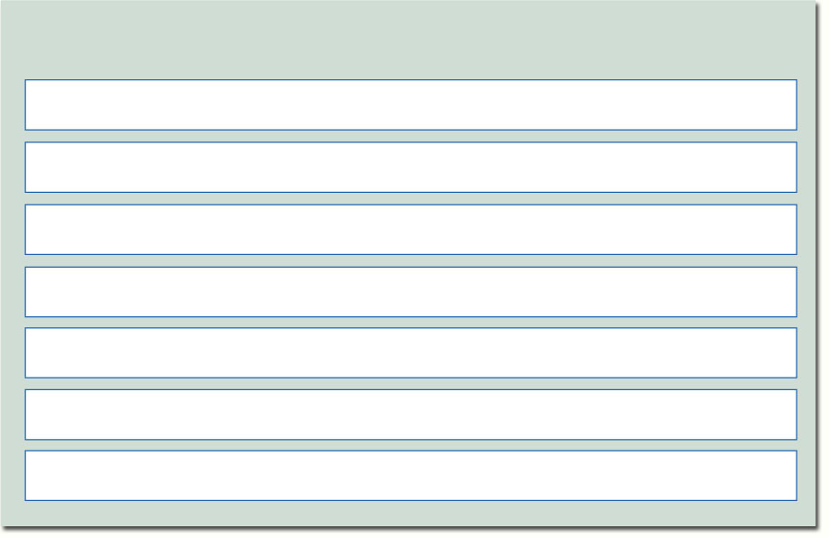
The Fourth Step in the Accounting Cycle: Posting
Section 7.2
The Posting Process
Six steps required for posting journal entries to a ledger:
1
Enter the date of the journal entry in the Date column.
2
The Description column is left blank, but can be used to write in the source document number.
3
Enter journal letter and page number in Post. Ref. column.
4
Enter the debit amount in the Debit column.
5
Compute the new account balance.
6
Enter the account number in the general journal Post. Ref. column.
7
Repeat steps 1–6 for the credit part of the journal entry.
Home

Slide 12
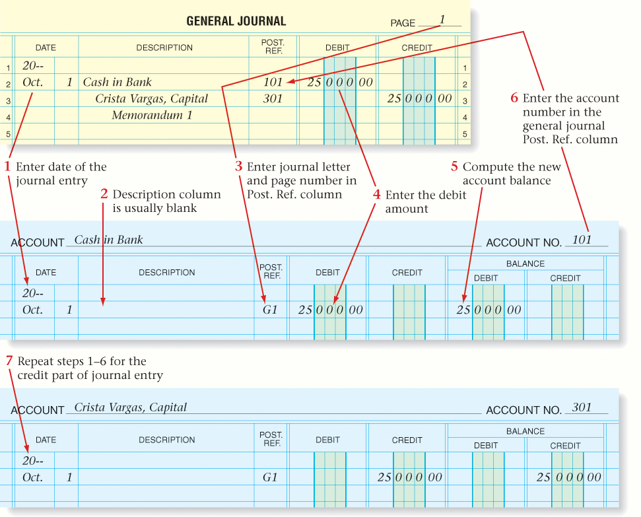
The Fourth Step in the Accounting Cycle: Posting
Section 7.2
The Posting Process
See page 172
Home

Slide 13
General Ledger Account Balances
Section 7.2
The Posting Process
A new account balance is computed each time a transaction is posted to an account.
the amount posted is a debit, ADD the amounts.
When the existing account balance is a debit, and
the amount posted is a credit, SUBTRACT the amounts.
Home

Slide 14
General Ledger Account Balances
Section 7.2
The Posting Process
A new account balance is computed each time a transaction is posted to an account.
the amount posted is a debit, SUBTRACT the amounts.
When the existing account balance is a credit, and
the amount posted is a credit, ADD the amounts.
Home

Slide 15
General Ledger Account Balances
Section 7.2
The Posting Process
A ledger account with several postings
See page 177
Home

Slide 16
General Ledger Account Balances
Section 7.2
The Posting Process
A ledger account with a zero balance
See page 177
Home

Slide 17
Section 7.3
Preparing a Trial Balance
Key Terms
Proving the ledger
Trial balance
Transposition error
Slide error
Correcting entry
Home

Slide 18
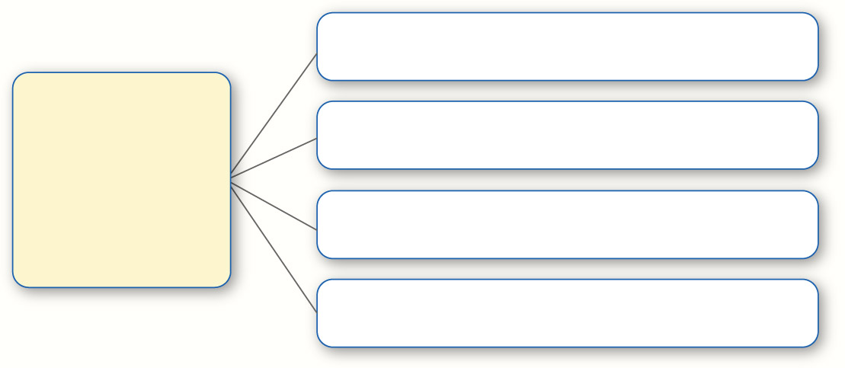
The Fifth Step in The Accounting Cycle: The Trial Balance
Section 7.3
Preparing a Trial Balance
Calculate the balance.
Necessary steps to keep an accounting system in balance:
Find any errors that may have occurred.
Use general rules and guidelines to narrow down where and why the mistake was made.
Correct the mistake.
Home

Slide 19
The Fifth Step in The Accounting Cycle: The Trial Balance
Section 7.3
Preparing a Trial Balance
=
Proving the Ledger
Sum of Debits
Sum of Credits
proving the ledger
Adding all debit balances and all credit balances of ledger accounts, and then comparing the two totals to see whether they are equal.
Home

Slide 20
The Fifth Step in The Accounting Cycle: The Trial Balance
Section 7.3
Preparing a Trial Balance
Proving the Ledger
If the totals are equal, the trial balance is in balance.
If the totals are not equal, add up the columns again.
trial balance
A list of all the general ledger account names and balances; it is prepared to prove the ledger.
Home

Slide 21
Finding and Correcting Errors
Section 7.3
Preparing a Trial Balance
Example of a Transposition Error
$469 was written as $496
transposition error
Error that occurs when two digits within an amount are accidentally reversed, or transposed.
Home

Slide 22
Finding and Correcting Errors
Section 7.3
Preparing a Trial Balance
Example of a Slide Error
$25,000 was written as $2,500
slide error
Error that occurs when a decimal point is moved by mistake.
Home

Slide 23
Finding and Correcting Errors
Section 7.3
Preparing a Trial Balance
Post the entry in the ledger the same as any other entry.
Correcting entry procedure:
Use the words correcting entry in the description column.
correcting entry
An entry made to correct an error in a journal entry discovered after posting.
Home

Slide 24
Finding and Correcting Errors
Section 7.3
Preparing a Trial Balance
Making a correcting entry to the general journal
See page 182
Home

Slide 25
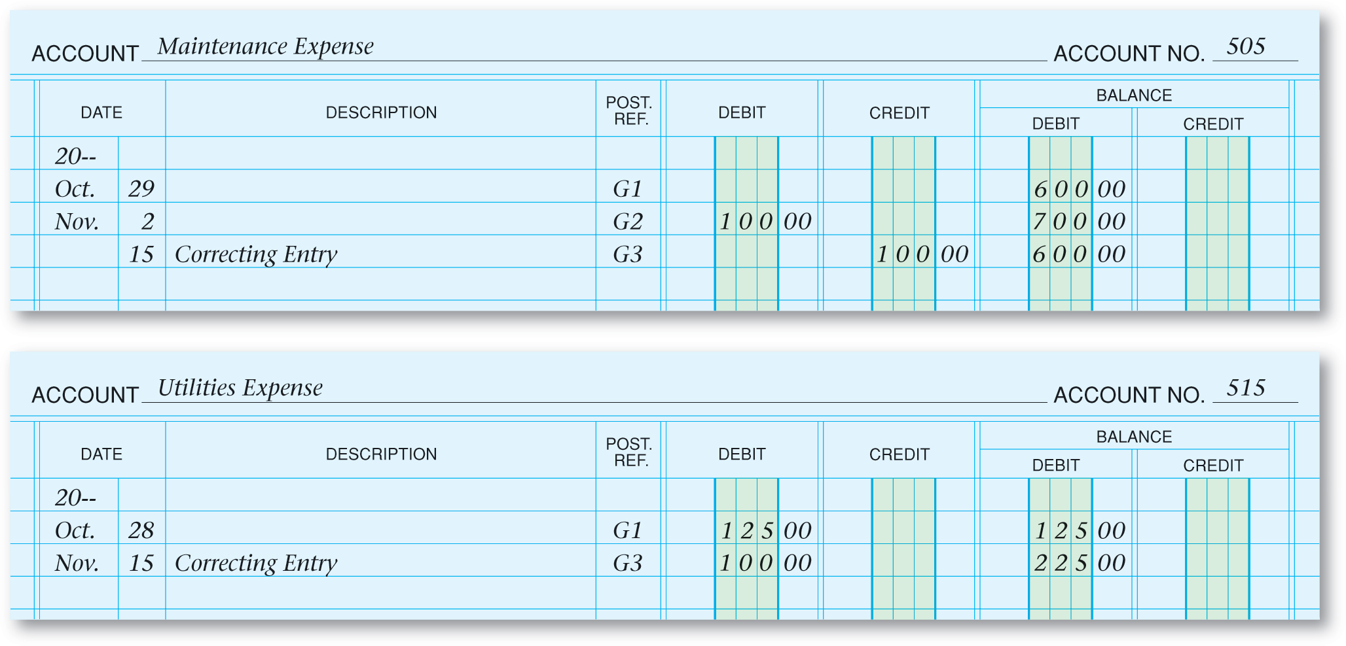
Finding and Correcting Errors
Section 7.3
Preparing a Trial Balance
Posting correcting entries to ledger accounts
See page 182
Home

Slide 26
Question 1
You have just completed a trial balance and the columns are not equal. List the steps that you would use to find the error.
Step 1: Check the addition in each column.
Step 2: Find the difference between the amounts in the Debit and Credit columns. If the difference is 10, 100, etc., you probably have made an addition error.
Step 3: If the difference found in Step 2 is divisible by 9, you have probably made a slide or transposition error.
Step 4: Check to see whether any of the general ledger accounts has a balance equal to the difference found in Step 2.
(continued)
Home

Slide 27
Question 1
You have just completed a trial balance and the columns are not equal. List the steps that you would use to find the error.
Step 5: Check to see whether any of the general ledger accounts has a balance equal to one-half of the difference. This would indicate that you may have moved a debit balance to the credit side of the trial balance or vice versa.
Step 6: Check the accuracy of the general ledger accounts by recalculating the balances.
Step 7: Check the individual postings from the general journal to the general ledger to make sure you have correctly posted the amounts and posted debits as debits and credits as credits.
(continued)
Home

Slide 28
Question 2
Is it possible to have amounts in both the Debit and Credit balance columns of a four-column ledger account?
No, the balance columns exist to show the cumulative effect of debits and credits to an account. If debits exceed credits, the account will have a debit balance, which is entered in the Debit column. If credits exceed debits, the account will have a credit balance, which is entered in the Credit column.
Home

Slide 29
End of
Home

