Slide 1
Home

Slide 2
The work sheet organizes general ledger account information for the financial statements. After completing the work sheet, you will know the net income or net loss for the accounting period.
Home
Glencoe Accounting
Copyright © by The McGraw-Hill Companies, Inc. All rights reserved.

Slide 3
Explain the purpose of the six-column work sheet.
Describe the parts of a six-column work sheet.
Prepare a six-column work sheet.
Calculate net income and net loss.
Home
Glencoe Accounting
Copyright © by The McGraw-Hill Companies, Inc. All rights reserved.

Slide 4
Section 8.1
Preparing the Work Sheet
Key Terms
work sheet
ruling
Home

Slide 5
The Sixth Step of the Accounting Cycle: The Work Sheet
Section 8.1
Preparing the Work Sheet
An accountant uses a work sheet to:
Gather information to prepare financial statements.
Complete other end-of-period activities.
work sheet
A working paper used to collect information from the ledger accounts for use in completing end-of-period activities.
Home

Slide 6
The Work Sheet Sections
Section 8.1
Preparing the Work Sheet
1. Heading
Zip Delivery Service
2. Account Name
3. Trial Balance
4. Income Statement
5. Balance Sheet
See page 200
Home

Slide 7
The Work Sheet Sections
Section 8.1
Preparing the Work Sheet
The Heading
Zip Delivery Service
Who – The name of the business
What – The name of the accounting form
When – The period covered by the work sheet
Home

Slide 8
The Work Sheet Sections
Section 8.1
Preparing the Work Sheet
Account Name
Zip Delivery Service
This section contains a listing of all accounts from the general ledger. Include accounts with a zero balance to avoid accidentally omitting an account.
Home

Slide 9
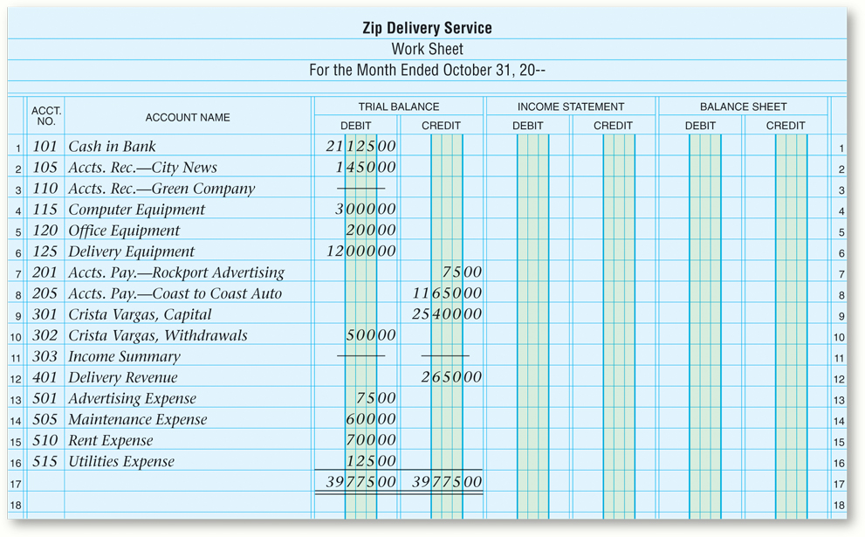
The Work Sheet Sections
Section 8.1
Preparing the Work Sheet
Account Name
Home
See page 201

Slide 10
The Work Sheet Sections
Section 8.1
Preparing the Work Sheet
Trial Balance
Zip Delivery Service
There are two steps to follow after this section is complete:
Ruling the Trial Balance section
Totaling the Trial Balance section
See page 200
Home

Slide 11
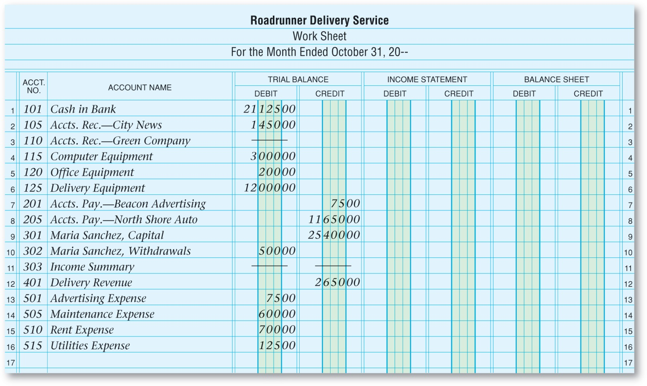
The Work Sheet Sections
Section 8.1
Preparing the Work Sheet
Trial Balance
Zip Delivery Service
Crista Vargas,
Crista Vargas,
Home
See page 202

Slide 12
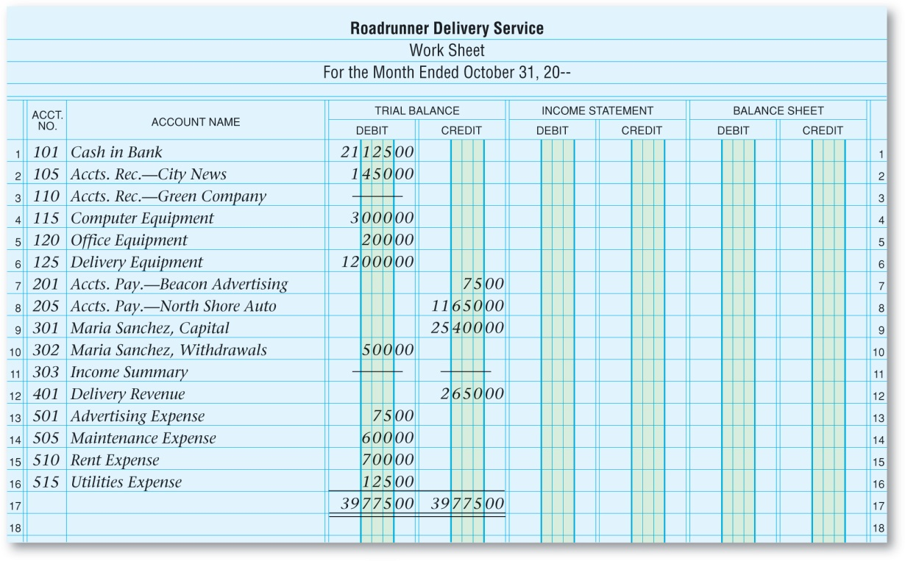
The Work Sheet Sections
Section 8.1
Preparing the Work Sheet
Ruling the Trial Balance Sections
Zip Delivery Service
ruling
Drawing a line; a single rule (line) drawn under a column of figures indicates that the entries above the rule are to be added or subtracted. If an amount is a total and no further processing is needed, a double rule is drawn under it.
Crista Vargas,
Crista Vargas,
Home

Slide 13
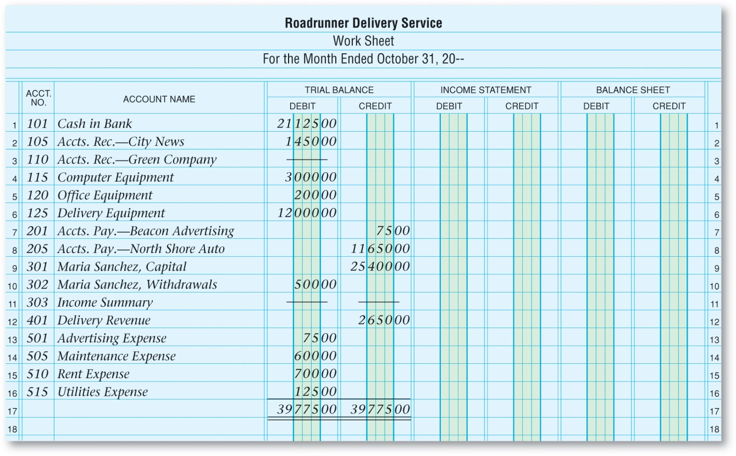
The Work Sheet Sections
Section 8.1
Preparing the Work Sheet
Totaling the Trial Balance Section
Zip Delivery Service
A double line is drawn under the totals to identify the above numbers as totals.
Crista Vargas,
Crista Vargas,
See page 202
Home

Slide 14
Section 8.2
Completing the Work Sheet
Key Terms
matching principle
net income
net loss
Home

Slide 15
The Balance Sheet and Income Statement Sections
Section 8.2
Completing the Work Sheet
Balance Sheet
Prepared at the end of the accounting period
Both are organized on the work sheet
Income Statement
Home

Slide 16
The Balance Sheet and Income Statement Sections
Section 8.2
Completing the Work Sheet
Balance Sheet Section
Amounts are transferred, or extended, from the Trial Balance section for these account types.
Owner’s Equity
Asset
Liability
Home

Slide 17
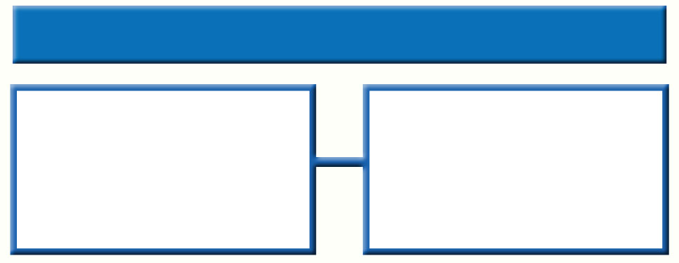
The Balance Sheet and Income Statement Sections
Section 8.2
Completing the Work Sheet
Income Statement Section
Amounts are extended from the Trial Balance section for these account types.
Revenue
Expense
Home

Slide 18
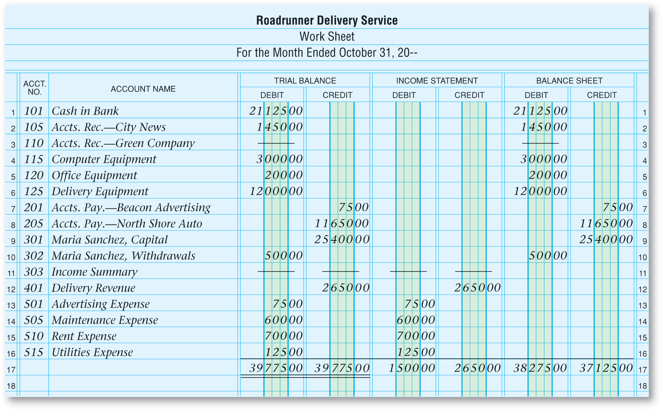
The Balance Sheet and Income Statement Sections
Section 8.2
Completing the Work Sheet
Zip Delivery Service
A single line is drawn below the entries in the Income Statement and Balance Sheet sections to indicate they are ready for totaling.
Once the columns are totaled, they will not be equal until the net income or net loss is added.
Crista Vargas,
Crista Vargas,
See page 206
Home

Slide 19
Showing Net Income or Net Loss on the Work Sheet
Section 8.2
Completing the Work Sheet
Analyzing Results
Matching principles are used by managers for:
Making Decisions
matching principle
Principle requiring that the expenses incurred in an accounting period are matched with revenue earned in the same period.
Home

Slide 20
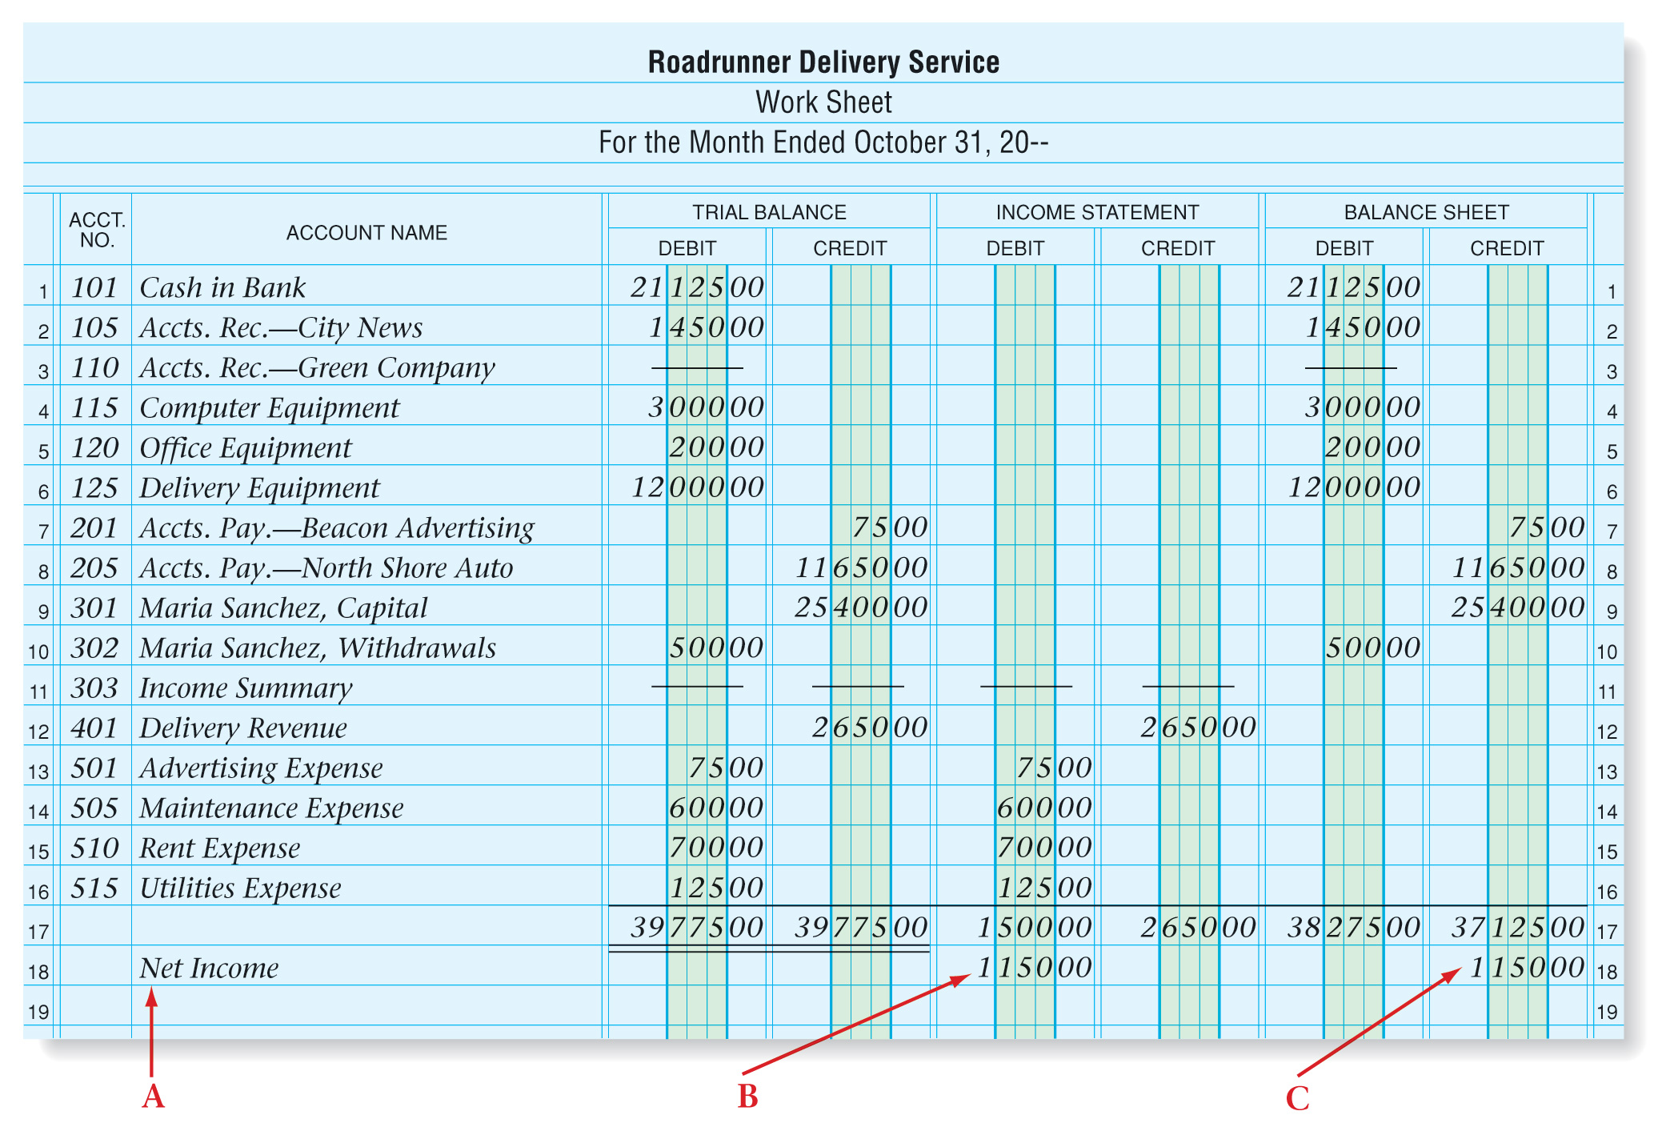
Showing Net Income or Net Loss on the Work Sheet
Section 8.2
Completing the Work Sheet
Showing Net Income on the Work Sheet
Zip Delivery Service
A - After the last account, skip a line and enter the words Net Income or Net Loss in the Account Name column.
See page 207
Home

Slide 21
Showing Net Income or Net Loss on the Work Sheet
Section 8.2
Completing the Work Sheet
Showing Net Income on the Work Sheet
Zip Delivery Service
B - On the same line, enter the net income total under the Income Statement Debit column, or the net loss under the Credit column.
Home

Slide 22
Showing Net Income or Net Loss on the Work Sheet
Section 8.2
Completing the Work Sheet
Showing Net Income on the Work Sheet
Zip Delivery Service
C - On the same line, enter the net income amount under the Balance Sheet Credit column, or the net loss under the Debit column.
Home

Slide 23
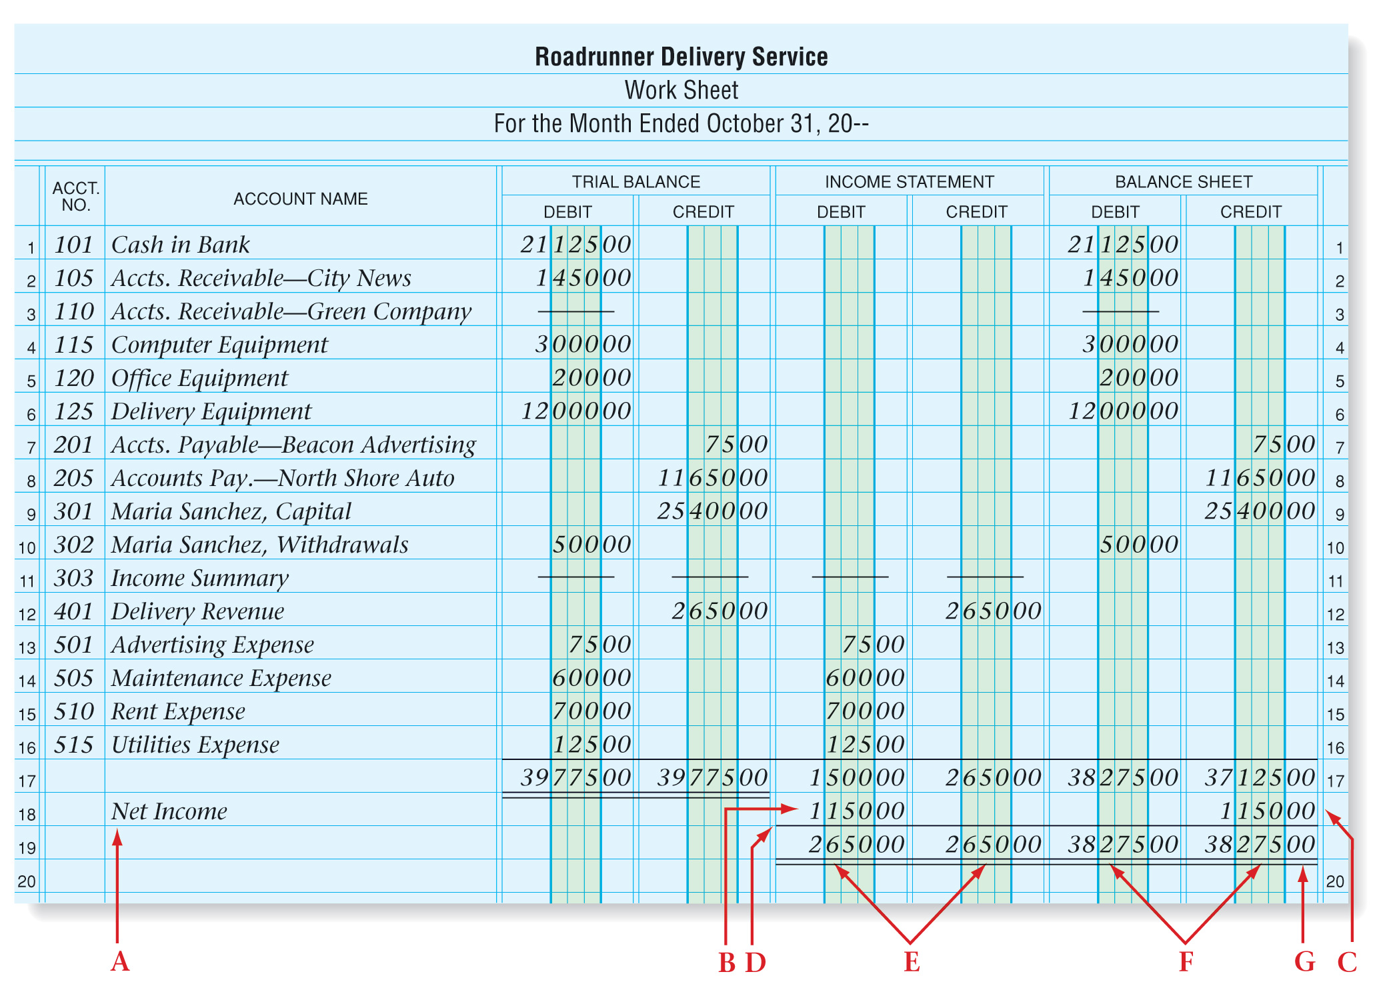
Showing Net Income or Net Loss on the Work Sheet
Section 8.2
Completing the Work Sheet
Showing Net Income
Zip Delivery Service
D - Draw a single rule across the four Income Statement and Balance Sheet columns below net income.
E - Bring down the Income Statement Debit and Credit column totals (after adding net income or net loss).
Showing Net loss
Home

Slide 24
Showing Net Income or Net Loss on the Work Sheet
Section 8.2
Completing the Work Sheet
Showing Net Income
Zip Delivery Service
F - Bring down the Balance Sheet Debit and Credit column totals (after adding net income or net loss).
G - Draw a double rule under the four Balance Sheet and Income Statement totals.
Showing Net loss
Total debits should equal total credits.
Home

Slide 25
Showing a Net Income or Net Loss on the Work Sheet
Section 8.2
Completing the Work Sheet
Showing Net Loss
See page 209
net loss
The amount by which total expenses exceed total revenue for the accounting period.
Home

Slide 26
A Review of the Six-Column Work Sheet
Section 8.2
Completing the Work Sheet
1
Enter the heading.
5
Total the Income Statement and Balance Sheet columns.
2
Enter account numbers, names, and balances.
6
Determine the net income or net loss.
Show that Trial Balance debits and credits are equal.
Enter the net income or net loss in the Income Statement and Balance Sheet columns.
3
7
4
Transfer the Trial Balance values to the Income Statement and Balance Sheet sections.
8
Total and rule the four columns.
Home

Slide 27
Question 1
List the steps involved in completing a six-column work sheet.
1
Enter the heading.
5
Total the Income Statement and Balance Sheet columns.
2
Enter account numbers, names, and balances.
6
Determine the net income or net loss.
Show that Trial Balance debits and credits are equal.
Enter the net income or net loss in the Income Statement and Balance Sheet columns.
3
7
4
Transfer the Trial Balance values to the Income Statement and Balance Sheet sections.
8
Total and rule the four columns.
Home

Slide 28
Question 2
Why are the Balance Sheet columns not equal for a business that has net income?
The Trial Balance will be equal, but when the revenue and expense items (temporary capital accounts) are separated from the Balance Sheet accounts, the Income Statement and Balance Sheet columns will be out of balance by the same amount. This happens because revenues increase and expenses decrease the owner’s equity account (capital). Net income occurs when revenue exceeds expenses. Therefore, the capital account will be out of balance by the amount of the net income.
Home

Slide 29
End of
Home

