Slide 1
Home

Slide 2
The income statement reports the net income or net loss for an accounting period. The statement of changes in owner’s equity shows how the owner’s financial interest changes during the accounting period. The balance sheet reports the financial position at a specific point in time. The statement of cash flows reports the sources and uses of cash during the accounting period.
Home
Glencoe Accounting
Copyright © by The McGraw-Hill Companies, Inc. All rights reserved.

Slide 3
Explain the purpose of the income statement.
Prepare an income statement.
Explain the purpose of the statement of changes in owner’s equity.
Prepare a statement of changes in owner’s equity.
Explain the purpose of the balance sheet.
Prepare a balance sheet.
Explain the purpose of the statement of cash flows.
Explain ratio analysis and compute ratios.
Home
Glencoe Accounting
Copyright © by The McGraw-Hill Companies, Inc. All rights reserved.

Slide 4
Section 9.1
The Income Statement
Key Terms
financial statements
income statements
Home

Slide 5
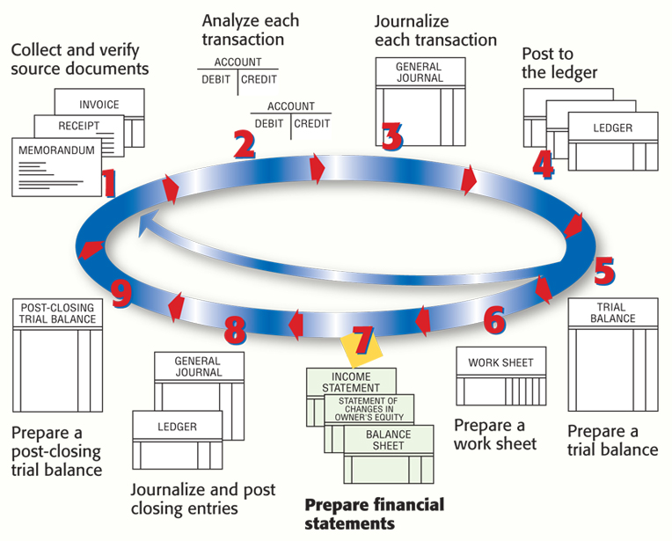
Financial Statements
Section 9.1
The Income Statement
Home

Slide 6
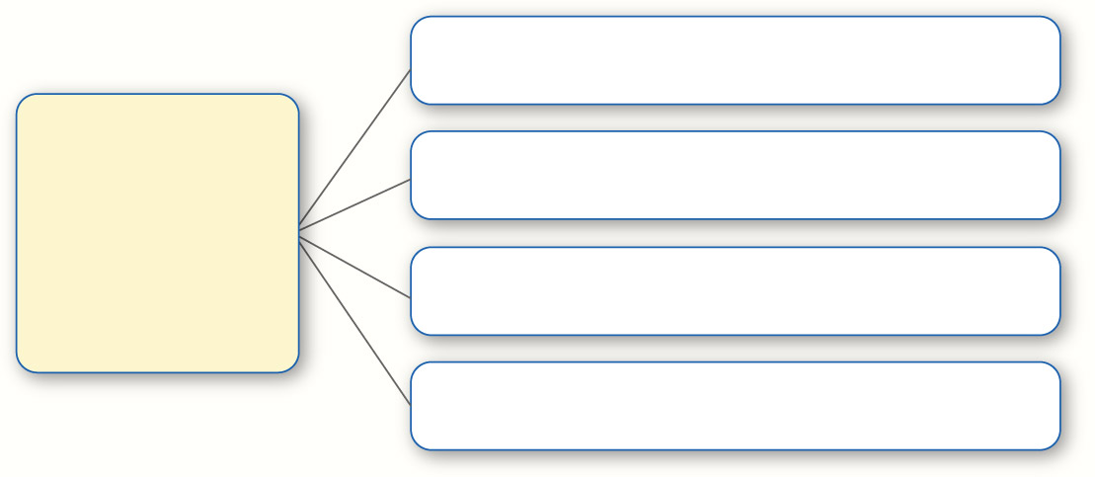
Financial Statements
Section 9.1
The Income Statement
Income Statement
Four Types of Financial Statements
Balance Sheet
Statement of Changes in Owner’s Equity
Statement of Cash Flows
financial statements
Reports prepared to summarize the changes resulting from business transactions that occur during an accounting period.
Home

Slide 7
The Income Statement
Section 9.1
The Income Statement
The Heading
Sections of the Income Statement
The Revenue for the Period
The Expenses for the Period
The Net Income or Net Loss
for the Period
income statement
A report of the net income or net loss for a specific period; sometimes called a profit-and-loss statement or earnings statement.
Home

Slide 8
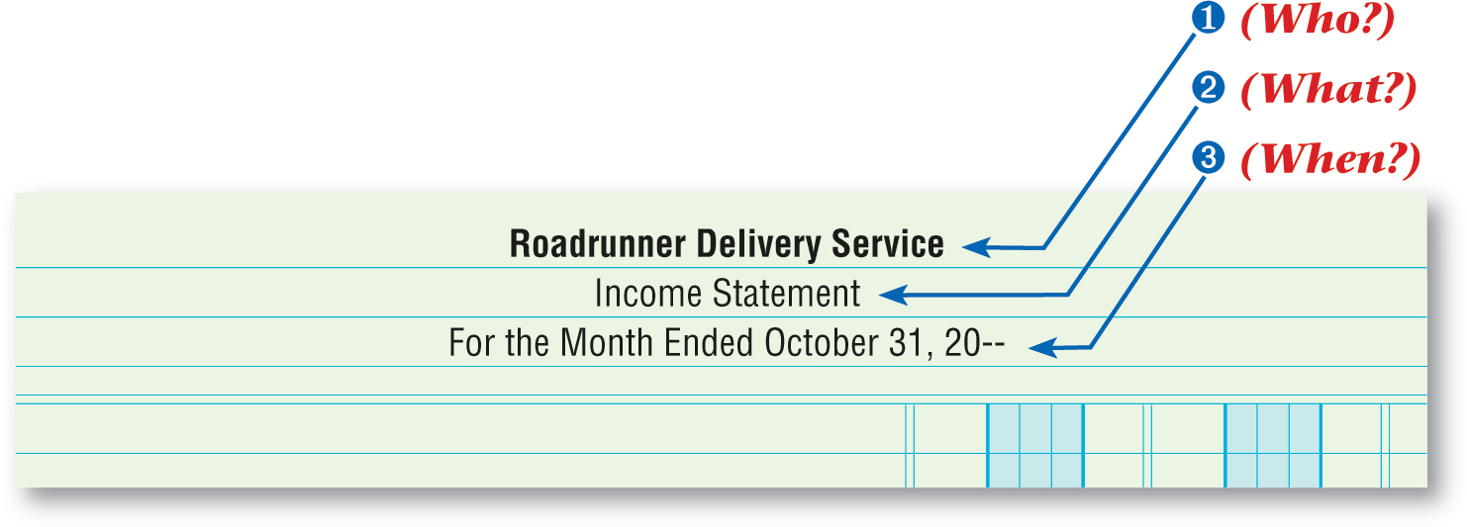
The Income Statement
Section 9.1
The Income Statement
Name of the business
The Heading
Name of the report
Period covered
Zip Delivery Service
See page 224
Home

Slide 9
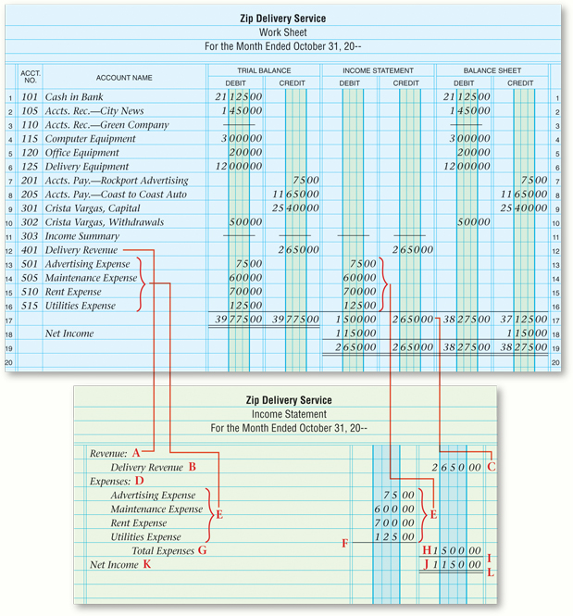
The Income Statement
Section 9.1
The Income Statement
Revenue Section
A
Write Revenue.
B
Enter revenue account names.
C
Enter the balance of each revenue account.
Home
See page 225

Slide 10
The Income Statement
Section 9.1
The Income Statement
Expenses Section
D
Write Expenses.
E
Enter expense account names.
F
Draw a single rule line under the last balance.
G
Write Total Expenses.
H
Add the balances for the expense accounts.
Home

Slide 11
The Income Statement
Section 9.1
The Income Statement
Net Income Section
I
Draw a single rule line under the total expenses amount.
J
Subtract the total expenses from total revenue.
K
Write Net Income.
L
If net income matches the amount on the work sheet, draw a double rule beneath the net income amount.
Home

Slide 12
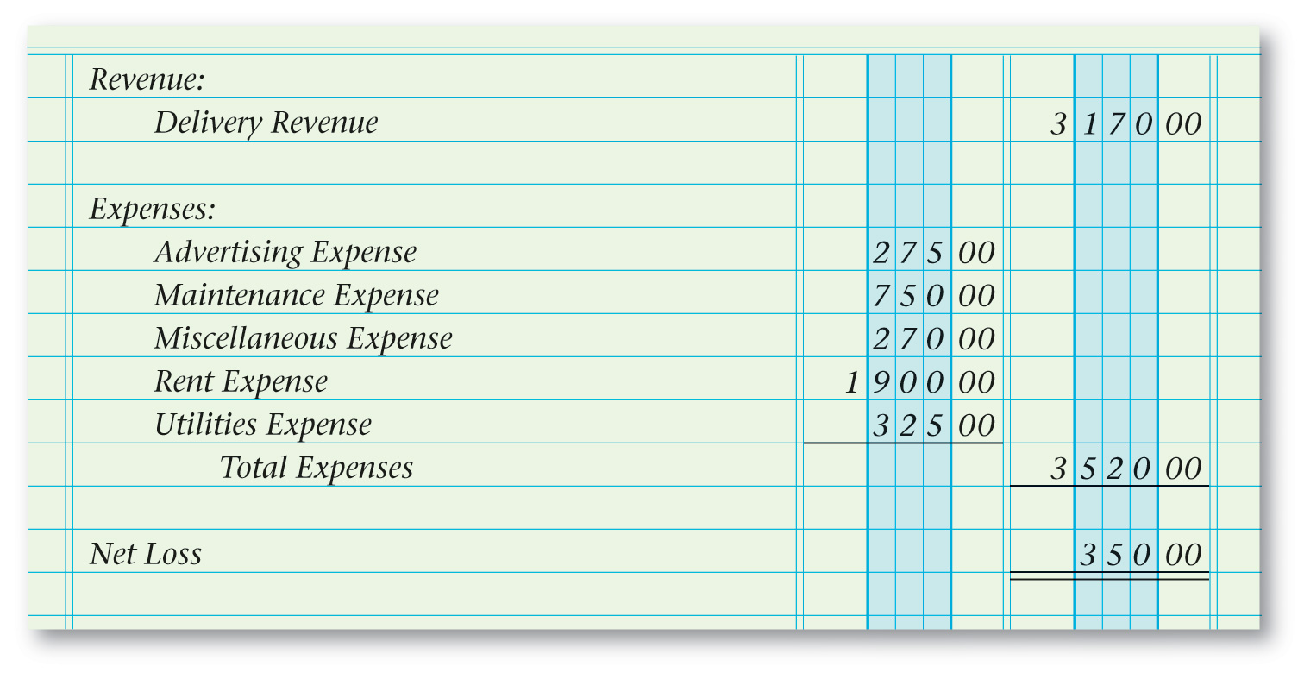
The Income Statement
Section 9.1
The Income Statement
Reporting a Net Loss
See page 226
Home

Slide 13
Section 9.2
The Statement of Changes in Owner’s Equity
Key Term
statement of changes in owner’s equity
Home

Slide 14
The Statement of Changes in Owner’s Equity
Section 9.2
The Statement of Changes in Owner’s Equity
The work sheet
Information needed to prepare the statement of changes in owner’s equity
The income statement
The owner’s capital account in the general ledger
statement of changes in owner’s equity
A financial statement that summarizes changes in the owner’s capital account as a result of business transactions during the period.
Home

Slide 15
Completing the Statement of Changes in Owner’s Equity
Section 9.2
The Statement of Changes in Owner’s Equity
Steps for Completing the Statement of Changes in Owner’s Equity
A
Write Beginning Capital.
D
Enter the total investment.
B
Enter the balance of the capital account.
E
Enter the words Net Income.
C
Enter the increases to the capital account.
Zip Delivery Service
Home
See page 229

Slide 16
Completing the Statement of Changes in Owner’s Equity
Section 9.2
The Statement of Changes in Owner’s Equity
Steps for Completing the Statement of Changes in Owner’s Equity
F
I
Write Ending Capital on the next line followed by a comma and the last day of the period.
Write Total Increase in Capital.
G
Write Subtotal.
J
Subtract the withdrawals amount from the subtotal.
H
List the decreases to the capital account. Enter the withdrawals amount and draw a single rule under the withdrawals amount.
Zip Delivery Service
Home

Slide 17
Completing the Statement of Changes in Owner’s Equity
Section 9.2
The Statement of Changes in Owner’s Equity
Look at the ledger.
There are two ways to determine the owner’s capital account balance:
Subtract additional investments from the balance shown on the work sheet.
For an ongoing business, the capital account balance on the work sheet may not be the balance at the beginning of the period.
Home

Slide 18
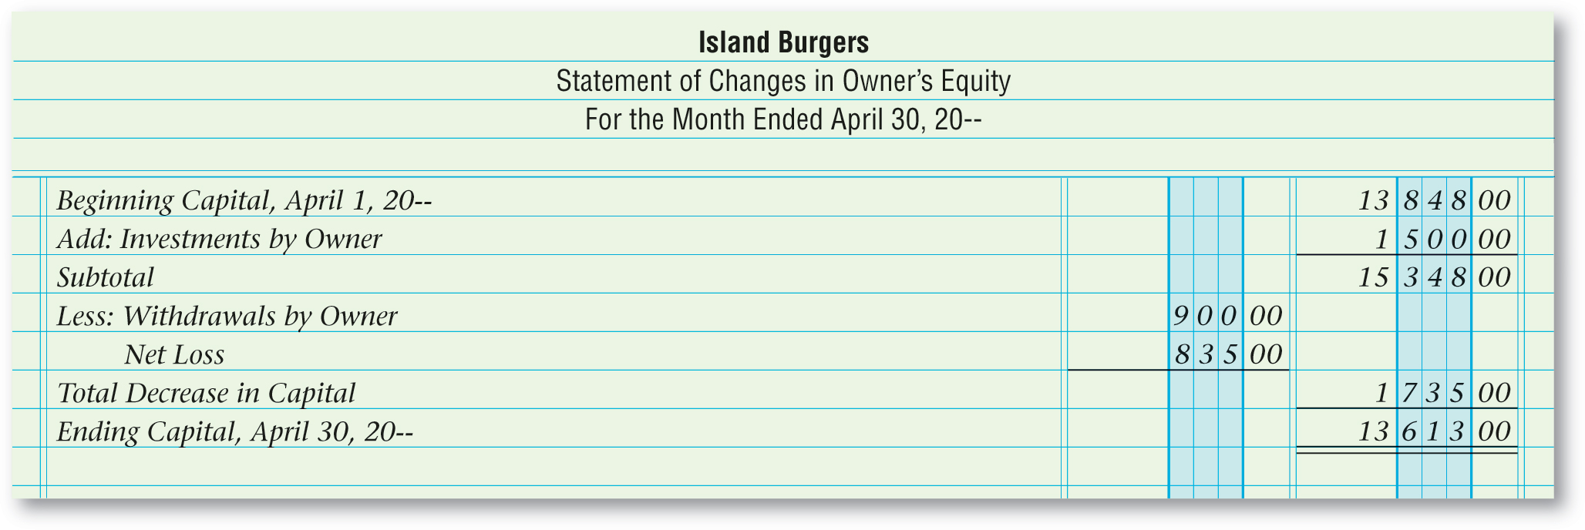
Completing the Statement of Changes in Owner’s Equity
Section 9.2
The Statement of Changes in Owner’s Equity
Statement of Changes in Owner’s Equity Showing a Net Loss
Island Burgers
See page 231
Home

Slide 19
Section 9.3
The Balance Sheet and the Statement of Cash Flows
Key Terms
balance sheet
report form
statement of cash flows
ratio analysis
profitability ratio
return on sales
current assets
current liabilities
working capital
liquidity ratio
current ratio
quick ratio
Home

Slide 20
The Balance Sheet
Section 9.3
The Balance Sheet and the Statement of Cash Flows
The Balance Sheet Summarizes:
What a business owns
What a business owes
What a business is worth
balance sheet
A report of the balances in the permanent accounts on a specific date.
Home

Slide 21
The Balance Sheet
Section 9.3
The Balance Sheet and the Statement of Cash Flows
Sections of the Balance Sheet
Liabilities and Owner’s Equity
The Heading
Assets
WHO The name of the business
WHAT The name of the financial statement
WHEN The date of the balance sheet
Home

Slide 22
The Balance Sheet
Section 9.3
The Balance Sheet and the Statement of Cash Flows
A balance sheet can be recorded in report form.
report form
A balance sheet format that lists classifications one under another.
Home

Slide 23
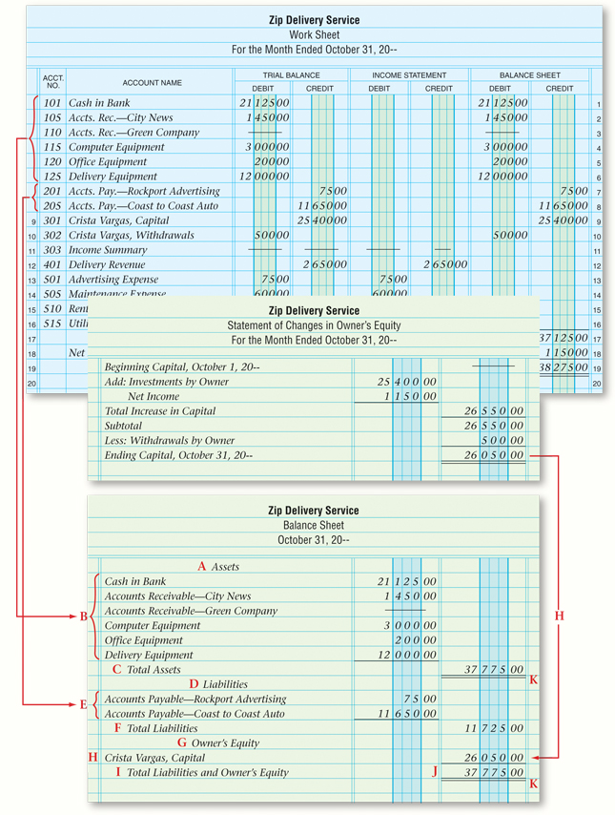
The Balance Sheet
Section 9.3
The Balance Sheet and the Statement of Cash Flows
Assets Section
A
Write Assets.
List each asset account and draw a single rule under the last account balance.
B
C
Write Total Assets and enter the total of individual asset balances.
Home
See page 235

Slide 24
The Balance Sheet
Section 9.3
The Balance Sheet and the Statement of Cash Flows
Liabilities and Owner’s Equity Sections
D
Write Liabilities.
List the liability account names and balances and draw a single rule beneath the last account balance.
E
F
Write Total Liabilities and enter the total of individual liability balances.
G
Write Owner’s Equity.
H
Write the name of the capital account and enter the ending balance of the capital account.
Home

Slide 25
The Balance Sheet
Section 9.3
The Balance Sheet and the Statement of Cash Flows
Proving the Equality of the Balance Sheet
Draw a single rule beneath the capital account balance and write Total Liabilities and Owner’s Equity on the next line.
Add the total liabilities amount and the ending capital balance and enter this value in the second amount column.
Draw a double rule under the total assets amount and under the total liabilities and owner’s equity amount if the two values are equal.
Home

Slide 26
The Statement of Cash Flows
Section 9.3
The Balance Sheet and the Statement of Cash Flows
The amount of cash the business took in
The sources of cash
Statement of Cash Flows
The amount of cash the business paid out
The uses of cash
statement of cash flows
A financial statement that summarizes the cash receipts and cash payments resulting from business activities during a period.
Home

Slide 27
Ratio Analysis
Section 9.3
The Balance Sheet and the Statement of Cash Flows
What is ratio analysis?
ratio analysis
The process of evaluating the relationship between various amounts in the financial statements.
Home

Slide 28
Ratio Analysis
Section 9.3
The Balance Sheet and the Statement of Cash Flows
What is a profitability ratio?
profitability ratio
A ratio used to evaluate the earnings performance of a business during the accounting period.
Home

Slide 29
Ratio Analysis
Section 9.3
The Balance Sheet and the Statement of Cash Flows
Calculating the return on sales
$1,150 net income
=
0.434 or 43.4%
$2,650
return on sales
A ratio that examines the portion of each sales dollar that represents profit; calculated by dividing net income by sales.
Home

Slide 30
Ratio Analysis
Section 9.3
The Balance Sheet and the Statement of Cash Flows
Examples of Current Assets
Account Receivable
current assets
Assets that are used up or converted to cash during the normal operating cycle of the business.
Cash in Bank
Supplies
Home

Slide 31
Ratio Analysis
Section 9.3
The Balance Sheet and the Statement of Cash Flows
Accounts payable is an example of a current liability.
current liability
Debts of the business that must be paid within the next accounting period.
Home

Slide 32
Ratio Analysis
Section 9.3
The Balance Sheet and the Statement of Cash Flows
Current assets - current liability = working capital
working capital
The amount by which current assets exceed current liabilities.
Home

Slide 33
Ratio Analysis
Section 9.3
The Balance Sheet and the Statement of Cash Flows
What is a liquidity ratio?
liquidity ratio
A measure of the ability of a business to pay its current debts as they become due and to provide for an unexpected need for cash.
Home

Slide 34
Ratio Analysis
Section 9.3
The Balance Sheet and the Statement of Cash Flows
What is the current ratio?
current ratio
The relationship between current assets and current liabilities; calculated by dividing current assets by current liabilities.
Home

Slide 35
Ratio Analysis
Section 9.3
The Balance Sheet and the Statement of Cash Flows
What is the quick ratio?
quick ratio
A measure of the relationship between short-term assets and current liabilities; calculated by dividing the total cash and receivables by the current liabilities.
Home

Slide 36
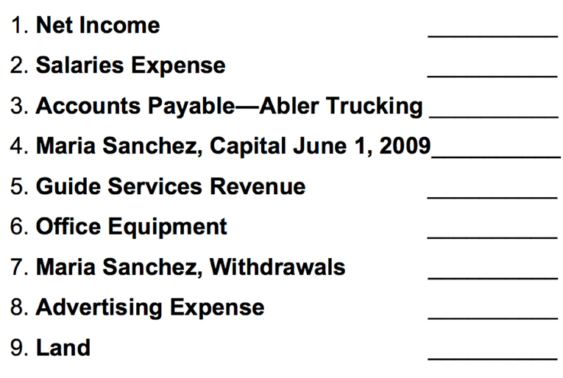
Question 1
Indicate with an I for income statement, a B for balance sheet, and an S for statement of changes in owner’s equity in which financial statement(s) you would most likely find the following.
I,S
I
B
S
I
B
S
I
B
Home

Slide 37
Question 2
How would you use the profitability and liquidity ratios to determine whether the business is moving in a positive direction?
A ratio is most useful when it is compared to the same ratio prepared at several different times for the same company or compared to the same ratio prepared for the industry of which the business is part.
Comparing to the industry average will let the owner or manager know how the business is performing in comparison to its competition.
Home

Slide 38
End of
Home

